Slide 1
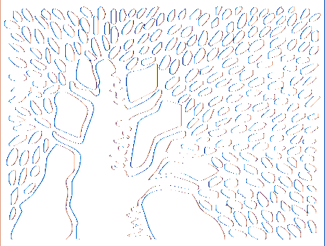
Micron-scale light transport decomposition using interferometry
Ioannis Gkioulekas¹
Anat Levin³
Fredo Durand²
Todd Zickler¹
¹Harvard SEAS
²MIT CSAIL
³Weizmann
Notes:
Thanks for the introduction.

Slide 2
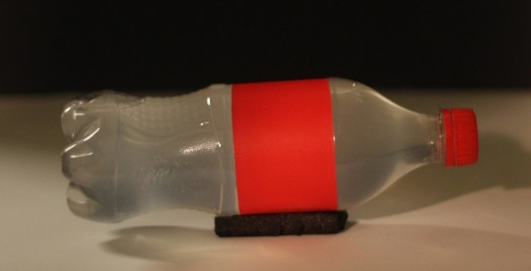
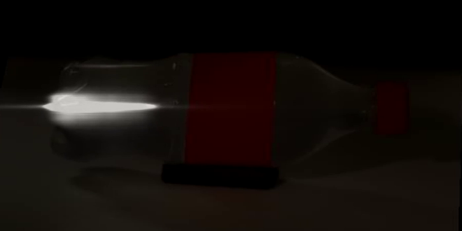
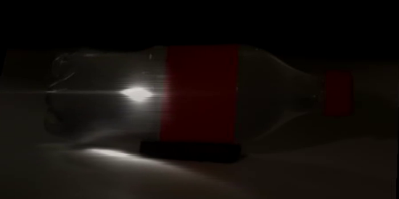
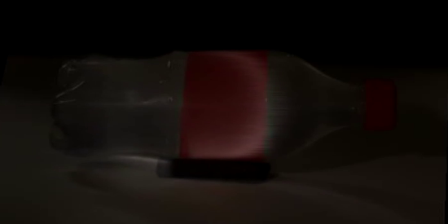
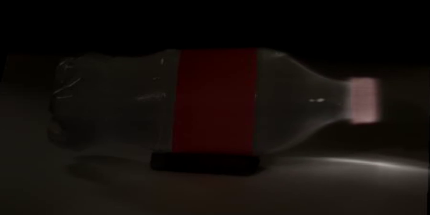
Light transport decompositions
light source
camera
Δt
transient imaging
[Velten et al. 2013]
spatial probing
+ transient imaging
[Heide et al. 2013]
[Kadambi et al. 2013]
using interferometry
[O’Toole et al. 2012]
1000x larger temporal resolution
[O’Toole et al. 2014]
Notes:
I will be talking about light transport decompositions. And I am using this, perhaps obscure, term to collectively refer to a number of different kinds of imaging that have attracted a lot of attention in computer graphics the last few years.
One such decomposition is transient imaging. This was introduced in computer graphics a few years ago by Velten et al., as a way of recording light waves propagating through a scene, for instance as in this famous example from that paper. Since then, a lot of other techniques for transient imaging have been proposed.
To justify the term decomposition, let’s look at how a standard image the same scene would be formed. Each camera pixel would receive photons that started on different points on the source illuminating the soda bottle. Those photons would reflect and scatter in different ways, and as a result travel for different amounts of time before reaching the camera.
What transient imaging does, then, is decompose the regular image into a sequence of a few billion frames, where each frame only has contributions from photons that travelled for some specific amount of time.
Another type of decomposition is spatial probing, a term introduced by O’Toole et al. Spatial probing means breaking the conventional image into the image that would be formed if each camera pixel only received photons that began on certain points on the source, determined by the probing pattern.
O’Toole et al. also showed that spatial probing can be combined with transient imaging, allowing to decompose photon contributions in terms of both time travelled and point of origin on the source.
What I will show you is a new way for doing these types of decompositions. As you have probably guessed from the title of the talk, our method will rely on using interferometry. The main advantage of this new method is that that it dramatically improves the resolution at which we can between photon travel times. Specifically, using interferometry allows going from billion to trillion frames per seconds. You may be wondering, why would we ever need to do that? I will show you two examples where this increased resolution is important.

Slide 3
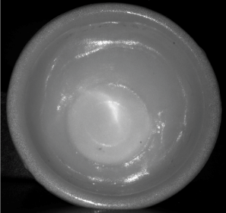
Tiny scenes
Δt
1 cm
toy cup
0.5 cm
Δt ps
~
Δt 10⁻³ ps
~
Notes:
The first example has to two with imaging small geometries. While all previous light transport decomposition techniques were designed for imaging table-top object or room-sized scenes, here we will be focusing on objects of dimensions at most a few centimeters, such as those shown here.
To show a concrete example, let’s look at this toy cup. Here is a frontal photo of it. The cup is about 1 cm wide and, if we look at a cross-section of the photo, half a centimeter deep
If we try taking a transient image of this scene with one of the existing techniques, the highest resolution we can use is in the order of a few nanoseconds. To get a better sense of scales, this is the time it takes light to travel at about half the depth of the cup. In other words, in just two transient frames, light will have already reached the deepest part of the cup.
By comparison, we will do transient imaging at a scale three orders of magnitude smaller than that, meaning that it takes a couple thousand frames just to travel through the cup. Here is a comparison of the actual transient images at the two resolutions. We see that using our finer resolution, beyond better reflecting the cup geometry, also allows us to accurately capture a large number of interesting scene phenomena, such as caustics and specular interrreflections. All of these details are blurred away in the low-res version.

Slide 4
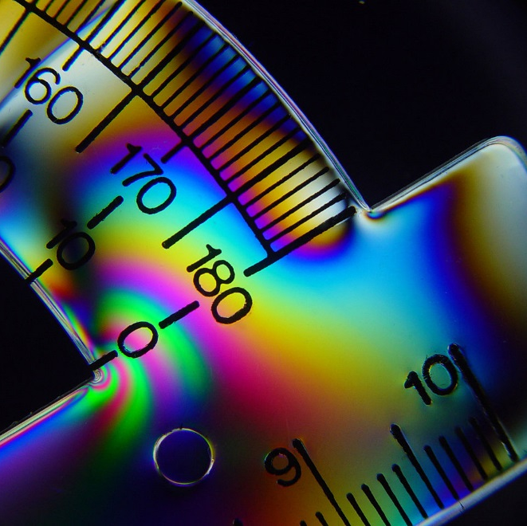
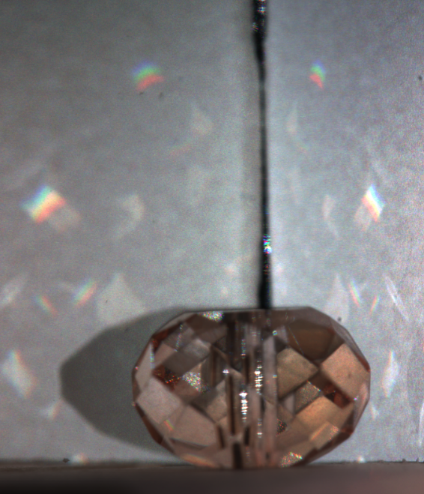
Material properties
birefringence
dispersion
scattering
Notes:
The second example case is when imaging real-world materials. Resolutions of the order our technique enables are necessary in order to accurately capture transient images of various material phenomena, such as birefringence, dispersion, and scattering. Let’s focus on dispersion for a bit.

Slide 5
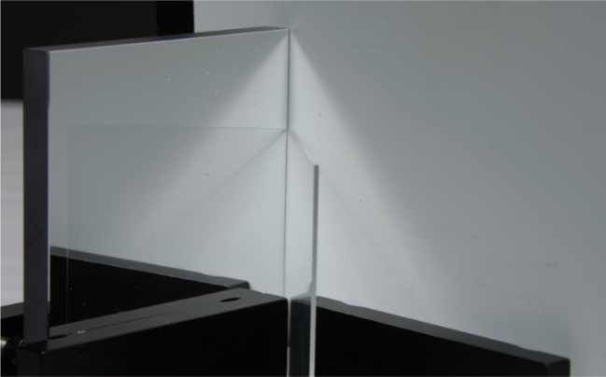
Dispersion
1 cm
mirror
diffuser
Δt ns
~
cropped frame
glass slab
mirror
diffuser
glass slab
Δt 10⁻³ ns
~
refractive index η(wavelength)
Notes:
To remind you of some high school physics, consider a wavefront of white light propagating towards a glass slab. The glass has a refractive index larger than 1, meaning that light will travel slower inside glass than it does in air. Moreover, this refractive index changes as a function of wavelength , meaning that different wavelengths get delayed by different amounts of time. This is called dispersion. The result of this is that, if we’re sitting on the other side of the slab measuring light as it comes to us, or in other words doing transient imaging, we will see first red, then green, then blue.
To see if we can actually measure this, we made this simple scene, consisting of a mirror-diffuser corner with a glass slab in the middle. Here is a 1-cm-wide frame. This frame shows the diffuser twice: once due to paths that reflect directly on the diffuser, and once more due to paths that reflect on the mirror, bounce on the diffuser, and then reflect on the mirror again. This second type of paths go through the glass slabs, and therefore are subject to dispersion. For the glass slab we used, the delays between different wavelengths are in the order of 20 microns.
Now, here are two transient images captured for this scene, at the resolution previously available and our improved one. Comparing the two, we first see that, as in the previous example, the low-res version loses most geometric information, as the entire diffuser appears simultaneously. In the high-res version, deeper parts of the diffuser appear later, as expected.
More importantly, in the high-res version, we see that a rainbow appears in the mirror side of the scene. This temporal rainbow, which is not visible in the regular photo of the scene, is exactly the dispersion behavior I described. Without being able to image at the scale we achieve, the dispersion properties of the material are completely lost.

Slide 6
Decompositions using interferometry
transient imaging
spatial probing + transient imaging
Notes:
To conclude this section, I’ve shown that the way to do direct-only transient imaging using interferometry is as follows: Use the same Michelson intereferometer and scanning procedure as for standard transient imaging, but change the source to be an area source such as an LED. In the paper, we show that we can additionally manipulate the shape of the mirror of the Michelson interferometer, to combine transient imaging with spatial probing patterns different than those corresponding to direct-only imaging. I will also mention briefly that, in the paper we discuss the case of doing spatial probing using interferometry, though we didn’t experiment with that as it does not offer any significant resolution advantages compared to existing techniques.
And with this, I’ve covered what I set out to do at the beginning. I’ve showed you how to use interferometry to do different kinds of light transport decompositions, in terms of both pathlength and pixel-camera correspondences. As I discussed, this has the advantage that it offers a much higher resolution than other techniques. Additionally, and I didn’t discuss this in detail but it may have become apparent from the results, the method is flexible enough to also allow decomposing by color or polarization.
However, this increased resolution comes at a cost, and it’s worth mentioning here the main disadvantages of these interferometric techniques. The first is that it is impractical to work with volumes larger than 5 by 5 by 5 cm. This is analogous to conventional macrophotography, where the increase in magnification comes at the cost of a very limited field of view and depth of field.
The second disadvantage is that interferometric techniques tend to have very long scanning times, in the order of 8 hours per scan.
Finally, and as a consequence of the above, these techniques can only be applied to static scenes. In fact, combined with the very small imaging resolution, the performance of intereferometric techniques can be terribly sensitive to tiny vibrations from the environment, for example by air flow or ground vibrations.

Slide 7
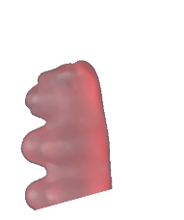
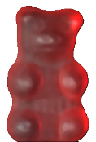
Transient imaging example
scene
light source
beamsplitter
light source
camera
Notes:
Since we’re focusing on small objects, let’s say we grab a gummy bear from the candy store, we put it next to a mirror, and then decide to image this scene.
We will be using a configuration where the scene is illuminated by a source and imaged by a camera that are both at the same spot and with the same viewpoint. Since physically co-locating the camera and the light source is impractical, we instead use a beamsplitter so that we can place the light source and camera at different positions, with the two still sharing the same viewpoint.

Slide 8
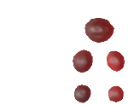
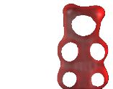
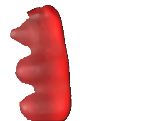
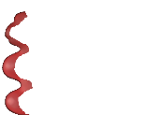
Transient imaging: light-in-flight
ultra-short pulse
transient image
scene
intensity
time
light source
beamsplitter
temporal resolution
ultra-fast
camera
Δt
time
Notes:
To capture a transient image of this scene using the method originally proposed by Velten et al., we would need to use two hardware components. First, a special source that can emit very short pulses of light, with a duration of a few femptoseconds. And second, an ultra-fast camera, that can capture a new image every few nanoseconds.
When a pulse is emitted, it propagates towards the scene. There, it is reflected and, eventually, reaches the camera that captures several frames while photons are reaching the sensor. These frames, when played as a video, are the transient image of the scene.
The time difference Dt between consecutive frames is the temporal resolution of our imaging system.

Slide 9
Transient imaging: pathlength decomposition
ultra-short pulse
transient image
scene
scene
intensity
τ
time
τ
light source
τ' > τ
τ' > τ
beamsplitter
pathlength resolution
temporal resolution
ultra-fast
camera
=
Δτ
c ∙
Δt
time
optical pathlength
Notes:
As we did mentioned earlier, we can multiply time with the speed of light, and think of everything in terms of distance. We can then replace temporal with pathlength resolution, now measured in units of distance.
Besides simply rewriting the resolution, this also allows us to think of transient imaging in terms of light paths travelling different distances. Each frame in a transient image is the image we would get if we could isolate photon contributions only from paths that have some specific optical length tau.
Whereas contributions from paths of length longer than tau will appear in later frames.
We see, then, that the transient image is equivalent to a pathlength decomposition of the light transport in our scene, and this is how I will be describing it in the rest of the talk.

Slide 10
Michelson interferometer
ultra-short pulse
scene
continuous wave
intensity
time
light source
beamsplitter
regular
ultra-fast
camera
scene
Notes:
Now let’s move on to a more conventional imaging setup a little bit. Let’s replace the ultra-fast camera with a regular one. Let’s also replace our pulse generator with a standard light source producing continuous wave illumination.
The camera will now capture a standard, steady-state image of the scene.
This image has simultaneously contributions from all different light paths in the scene, regardless of their length. This information is confounded in the image, and we cannot directly recover the pathlength decomposition from it.

Slide 11
Michelson interferometer
scene
same length
continuous wave
mirror
light source
beamsplitter
regular
camera
+
+
?
I(τ)
scene
mirror
interference
Notes:
Trying to undo this confounding, let’s consider expanding our setup by adding a mirror on the other end of the beamsplitter. This setup is now what is called in optics a Michelson interferometer.
In addition to the paths from the scene, the camera will now also receive contributions from paths that travel to the mirror.
As a result of these additional contributions, what the camera will be recording is the superposition of three components: the regular scene photo as before, the mirror image, and, also, a third component, corresponding to interference between scene and mirror paths.
While the scene and mirror images do not have any pathlength information, if we choose our source correctly, we can make the interference component be sensitive to pathlength.
Specifically, it will include contributions only from scene paths of the same optical length as the distance to the mirror. Or, in other words, the interference component is equal to one frame of the transient image of the scene.

Slide 12
Optical coherence tomography
transient image
scene
continuous wave
mirror
light source
Δτ
beamsplitter
translation stage
regular
camera
+
+
I(τ)
scene
mirror
interference
Notes:
This means we can do the following: place the mirror on a translating stage, then measure the interference component at every different position of the mirror. The sequence we measure this way will be exactly equivalent to the transient image of the scene we described earlier.
This setup and imaging procedure are known in optics as Optical Coherence Tomography, which is the basis for our approach to transient imaging.
The resolution we achieve by doing transient imaging this way does not depend on the stage and the translation steps it can achieve. Instead, it is controlled by the temporal coherence properties of the light source.

Slide 13
Temporal coherence
real field
temporal coherence length
same length
Δτ
(a.k.a. pathlength resolution)
light source
point source
correlation
wavelength
=
I(τ)
mirror position
interference
Notes:
I will take some time to explain temporal coherence in more detail. To do this, I will be focusing on one set of paths in our scene, and the corresponding mirror path.
We can now take a closer look at what exactly source we use. We will begin by assuming that we have a perfect point source, collimated by a lens. We’ll be relaxing this later. Let’s also assume that our source is polychromatic, with some non-zero spectral bandwidth.
Remember that light in reality is an electromagnetic field. If we focus on a certain point in these paths, the real part of this field will be a signal such as this one. This is produced as the sum of many perfect sinusoids, one for each frequency in the source’s spectrum.
The field is split into two copies by the beamsplitter. These copies are reflected by the scene and mirror, and then recombined on their way to the camera. By the time they reach the camera, the two fields will have travelled different distances. As a result, they will be shifted versions of each other, with the exact amount of the shift depending on the position of the mirror.
We can now express interference component the camera captures as the correlation of these two shifted copies of the fields. The correlation changes depending on their relative shift, and therefore on the mirror position. For a broadband source, this correlation signal has a characteristic behavior: Specifically, its amplitude becomes the largest when the mirror distance is equal to the length of the scene path. Moreover, the amplitude quickly decays as the difference between the mirror distance and the path length increases.
The amount of difference for which the interference magnitude remains non-zero is exactly the pathlength resolution of our imaging system, and in optics is given the special name "temporal coherence length". In effect, this controls the step-size at which we need to move our translation stage.
The temporal coherence length is determined completely by the bandwidth of the source. As the bandwidth increases, the temporal coherence length decreases and resolution improves. Conversely, if we make our source monochromatic, all fields become perfect sinusoids, the correlation also becomes a fixed-amplitude sinusoid, and as a result the interference component no longer carries any pathlength information. Therefore, we see that in order to do transient imaging, we have to use a broadband point source.

Slide 14
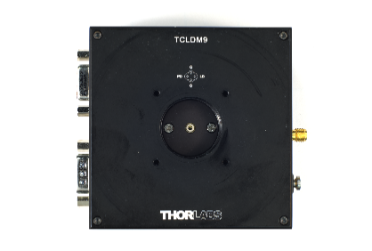
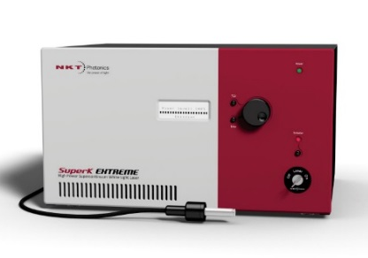
Temporal coherence length
bandwidth
correlation
broadband
25 nm
monochromatic
pathlength resolution Δτ 10 μm
~
very broadband
superluminescent diode
supercontinuum laser
Notes:
I will take some time to explain temporal coherence in more detail. To do this, I will be focusing on one set of paths in our scene, and the corresponding mirror path.
We can now take a closer look at what exactly source we use. We will begin by assuming that we have a perfect point source, collimated by a lens. We’ll be relaxing this later. Let’s also assume that our source is polychromatic, with some non-zero spectral bandwidth.
Remember that light in reality is an electromagnetic field. If we focus on a certain point in these paths, the real part of this field will be a signal such as this one. This is produced as the sum of many perfect sinusoids, one for each frequency in the source’s spectrum.
The field is split into two copies by the beamsplitter. These copies are reflected by the scene and mirror, and then recombined on their way to the camera. By the time they reach the camera, the two fields will have travelled different distances. As a result, they will be shifted versions of each other, with the exact amount of the shift depending on the position of the mirror.
We can now express interference component the camera captures as the correlation of these two shifted copies of the fields. The correlation changes depending on their relative shift, and therefore on the mirror position. For a broadband source, this correlation signal has a characteristic behavior: Specifically, its amplitude becomes the largest when the mirror distance is equal to the length of the scene path. Moreover, the amplitude quickly decays as the difference between the mirror distance and the path length increases.
The amount of difference for which the interference magnitude remains non-zero is exactly the pathlength resolution of our imaging system, and in optics is given the special name "temporal coherence length". In effect, this controls the step-size at which we need to move our translation stage.
The temporal coherence length is determined completely by the bandwidth of the source. As the bandwidth increases, the temporal coherence length decreases and resolution improves. Conversely, if we make our source monochromatic, all fields become perfect sinusoids, the correlation also becomes a fixed-amplitude sinusoid, and as a result the interference component no longer carries any pathlength information. Therefore, we see that in order to do transient imaging, we have to use a broadband point source.

Slide 15
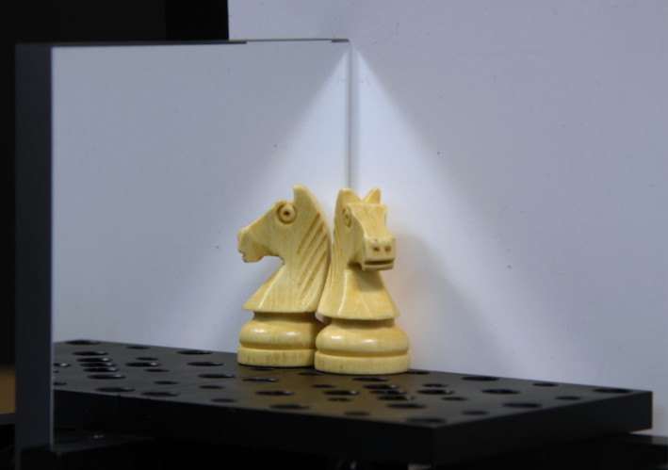
Some transient images
mirror
diffuser
diffuser
diffuser
centimeter-sized objects
Notes:
Let’s look now at some example transient images. For this, we will use objects of dimensions of 1-2 centimeters. In our examples, we place these objects in corner scenes consisting of either a mirror and a diffuser, or two diffuse walls.

Slide 16
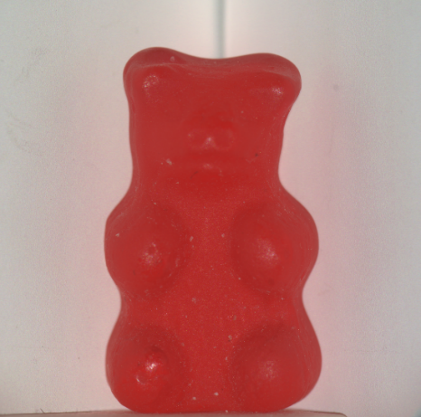
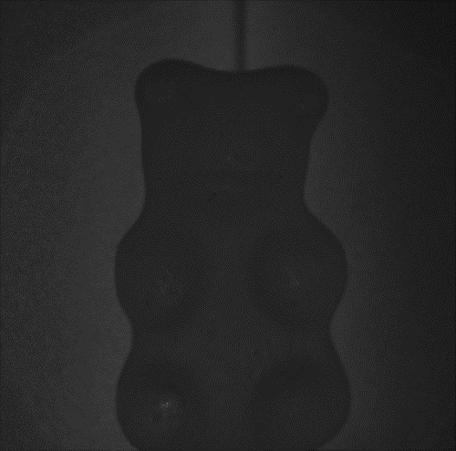
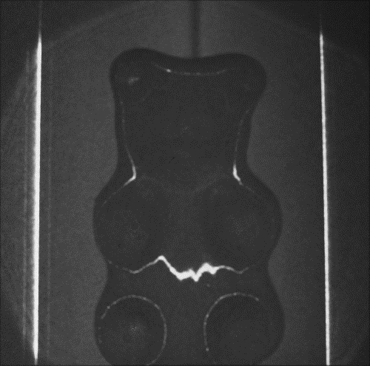
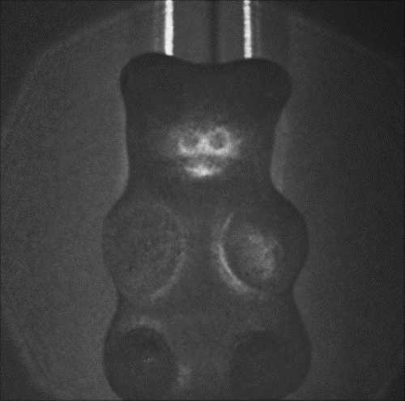
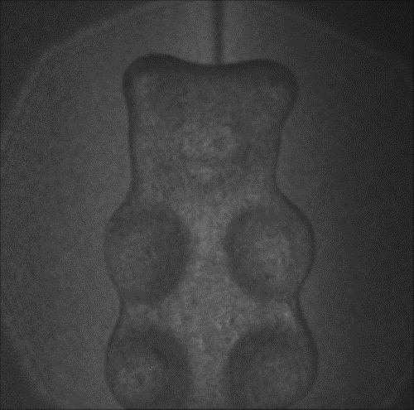
Gummy bear and diffuse corner
diffuser
diffuser
2 cm
pathlength (Δτ = 10 μm)
dark frame
surface reflections
paths through gummy bear
very highly scattered paths
Notes:
Our first example is a gummy bear in a diffuse corner.
And here's the transient video for this scene. We see that as light propagates, first it gets reflected on the gummy bear's surface, then it travels to the camera by travelling through the gummy bear. Finally, the gummy bear glows for a bit due to paths of very long scattering.

Slide 17
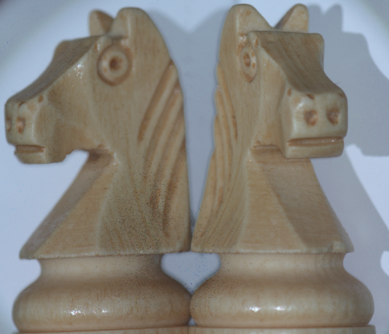
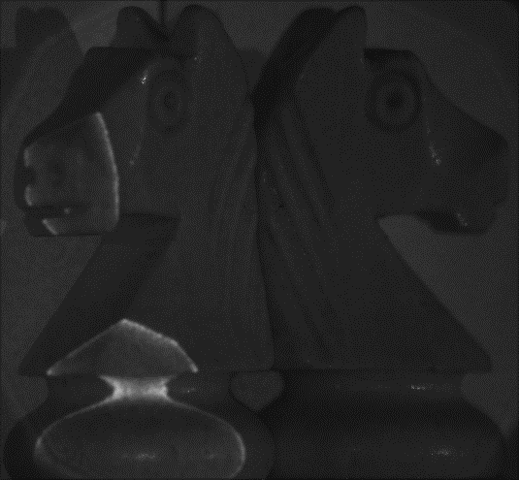
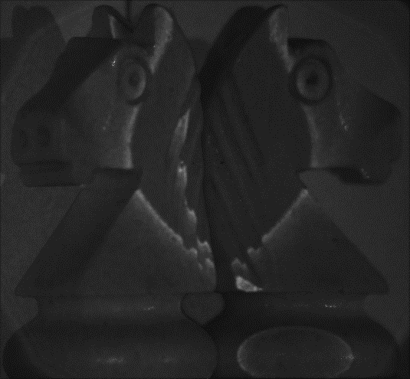
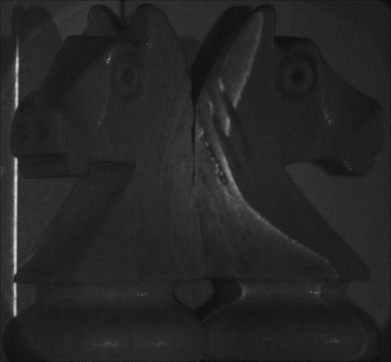
Chess knight and mirror
pathlength (Δτ = 10 μm)
mirror
diffuser
3 cm
pathlength (Δτ = 10 μm)
surface reflection
mirror-object object-mirror
mirror-object-mirror
Notes:
Here is another scene, with a chess piece placed between a diffuser and mirror.
As light propagates, we see different types of reflections from the object and mirror.

Slide 18
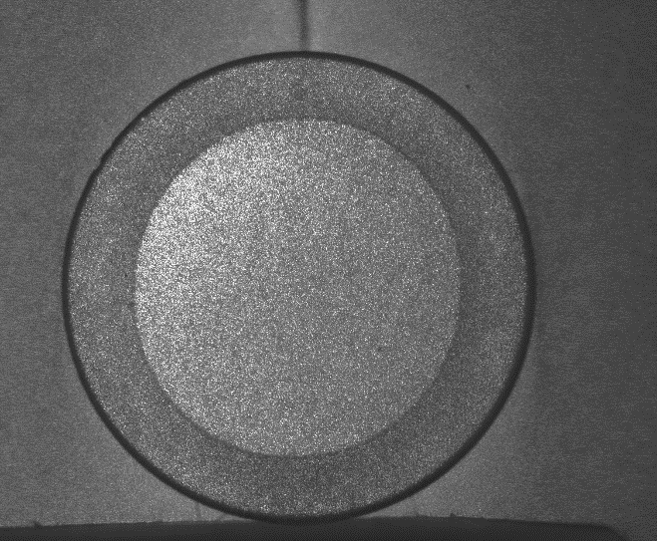
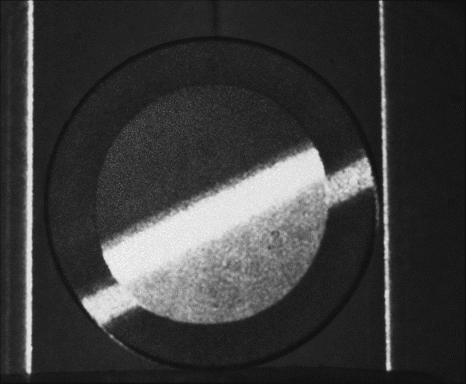
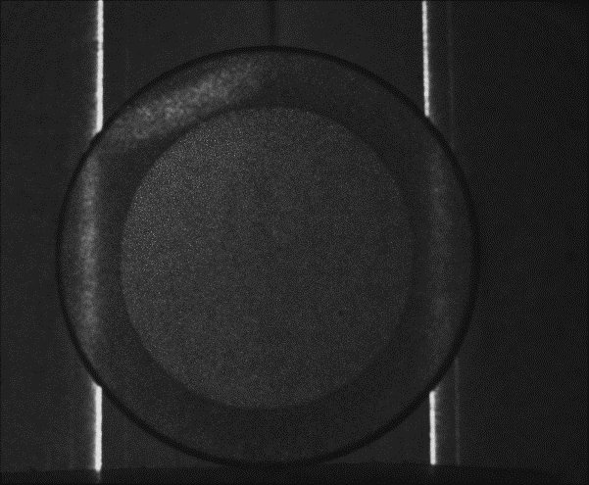
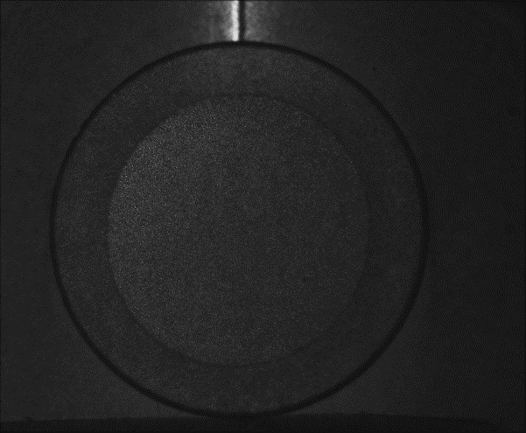
Subsurface scattering
diffuser
diffuser
1 cm
zirconia coating
ground glass plate
pathlength (Δτ = 10 μm)
surface reflection subsurface scattering
paths transmitted through ground glass
diffuse-diffuse reflections
Notes:
In this third scene, we measured a sample of a very highly scattering material called zirconia.
The material remains bright for several frames, due to all the paths corresponding to subsurface scattering. We also see other interesting effects, such as light travelling through the ground glass, and diffuse-diffuse interreflections at the corner.

Slide 19
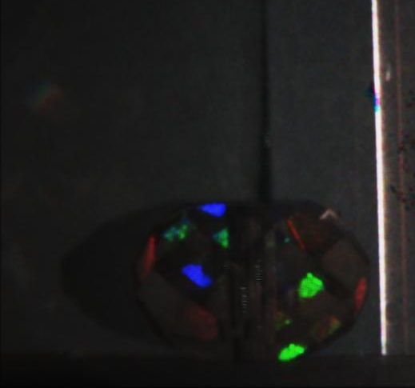
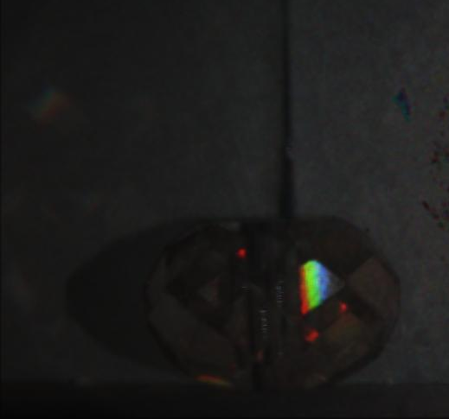
Dispersion
mirror
diffuser
1 cm
plastic bead
pathlength (Δτ = 10 μm)
facets changing color
surface reflections surface-wall reflections
rainbow
Notes:
Finally, here is a dispersion example.
Color effects and rainbows, white reflections.

Slide 20
Decompositions using interferometry
transient imaging
Michelson interferometer
scene
wavelength
mirror
broadband point source
spatial probing + transient imaging
light source
beamsplitter
translation stage
regular camera
Notes:
To conclude this section, I’ve shown that the way to do direct-only transient imaging using interferometry is as follows: Use the same Michelson intereferometer and scanning procedure as for standard transient imaging, but change the source to be an area source such as an LED. In the paper, we show that we can additionally manipulate the shape of the mirror of the Michelson interferometer, to combine transient imaging with spatial probing patterns different than those corresponding to direct-only imaging. I will also mention briefly that, in the paper we discuss the case of doing spatial probing using interferometry, though we didn’t experiment with that as it does not offer any significant resolution advantages compared to existing techniques.
And with this, I’ve covered what I set out to do at the beginning. I’ve showed you how to use interferometry to do different kinds of light transport decompositions, in terms of both pathlength and pixel-camera correspondences. As I discussed, this has the advantage that it offers a much higher resolution than other techniques. Additionally, and I didn’t discuss this in detail but it may have become apparent from the results, the method is flexible enough to also allow decomposing by color or polarization.
However, this increased resolution comes at a cost, and it’s worth mentioning here the main disadvantages of these interferometric techniques. The first is that it is impractical to work with volumes larger than 5 by 5 by 5 cm. This is analogous to conventional macrophotography, where the increase in magnification comes at the cost of a very limited field of view and depth of field.
The second disadvantage is that interferometric techniques tend to have very long scanning times, in the order of 8 hours per scan.
Finally, and as a consequence of the above, these techniques can only be applied to static scenes. In fact, combined with the very small imaging resolution, the performance of intereferometric techniques can be terribly sensitive to tiny vibrations from the environment, for example by air flow or ground vibrations.

Slide 21
Direct-only transient imaging
scene
point source
beamsplitter
regular
camera
Notes:
Now let’s move on to a more conventional imaging setup a little bit. Let’s replace the ultra-fast camera with a regular one. Let’s also replace our pulse generator with a standard light source producing continuous wave illumination.
The camera will now capture a standard, steady-state image of the scene.
This image has simultaneously contributions from all different light paths in the scene, regardless of their length. This information is confounded in the image, and we cannot directly recover the pathlength decomposition from it.

Slide 22
Direct-only transient imaging
direct paths
interference

same origin
same ray
spatial incoherence
indirect paths
no interference

different origins
different rays
Notes:
The paths have many qualitative differences. We note that, for the green path, light enters and leaves the scene along the same ray. For the purple path, on the other hand, light enters and exits along different rays. We call paths like green direct paths, and paths like purple indirect paths. Direct paths are normally single bounce reflections, whereas indirect paths correspond to global illumination effects such as multi-bounce interreflections and scattering.
Let’s add the mirror from the Michelson interferometer, and look at the corresponding mirror paths. We can now identify another qualitative difference. Direct paths match with mirror paths that begin on the same point of origin on the source. Indirect paths, on the other hand, match with mirror paths of different origin.
Using this second property, we could do direct-only transient imaging if we had a way to make scene and mirror paths interfere only if they have the same origin, and have zero interference otherwise.
This combination of properties is actually exactly the definition of another property of the source called spatial coherence. By making our source spatially incoherent, we can remove any contributions to the interference component from indirect paths, and therefore do direct-only transient imaging.

Slide 23
Direct-only transient imaging
scene
broadband LED
mirror
point
area
source
beamsplitter
translation stage
wavelength
regular
camera
Notes:
Now let’s move on to a more conventional imaging setup a little bit. Let’s replace the ultra-fast camera with a regular one. Let’s also replace our pulse generator with a standard light source producing continuous wave illumination.
The camera will now capture a standard, steady-state image of the scene.
This image has simultaneously contributions from all different light paths in the scene, regardless of their length. This information is confounded in the image, and we cannot directly recover the pathlength decomposition from it.

Slide 24
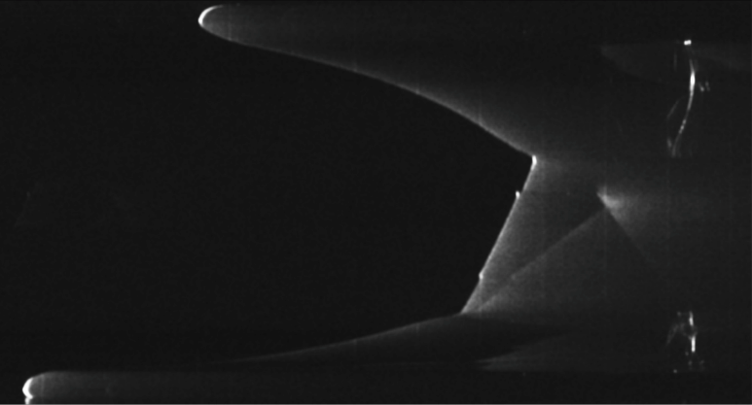
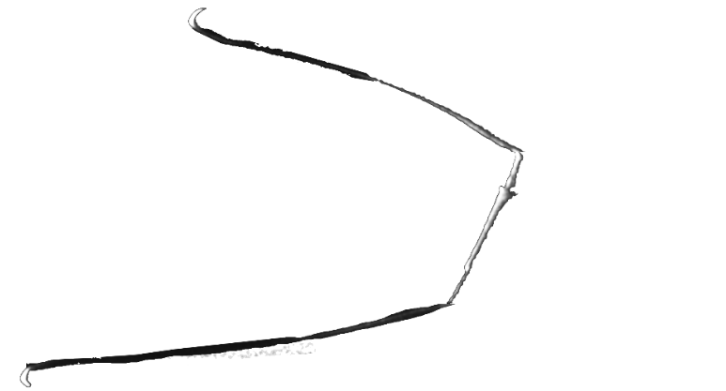
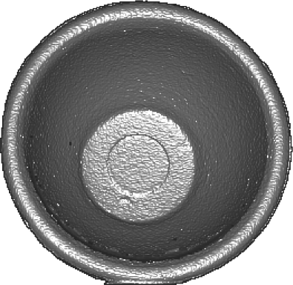
Toy cup
pathlength
full transient
caustics
one-bounce reflections
pixel
specular interreflections
pathlength
measured depth
direct-only transient
one-bounce reflections
pixel
Notes:
To compare the two different kinds of imaging, let's go back to the toy cup example, and play the two videos side-by-side.
To see the comparison better, we can visualize the measurements for a cross-section along the cup, as a function of pathlength.
We note that both the full and direct-only transient component measure one-bounce reflections off the cup's surface, producing the frames shown here.
But the full transient image also includes additional measurements corresponding to caustics and interreflections, for which the direct-only frames are zero.
What we can use this direct-only measurements for is to recover shape in a way that is robust to interreflections, which usually make shape scanning difficult. Here is the shape we recovered for this scene.

Slide 25
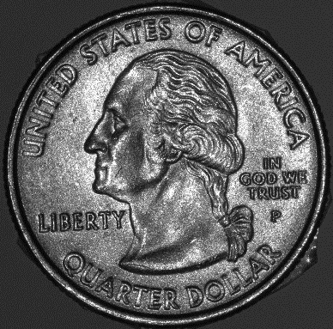
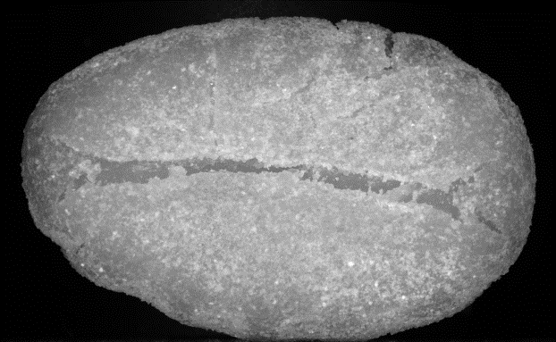
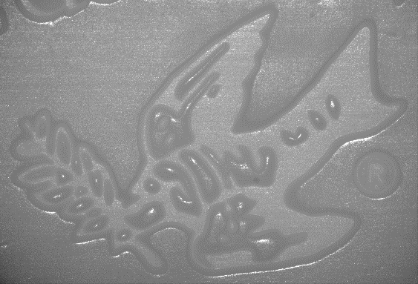
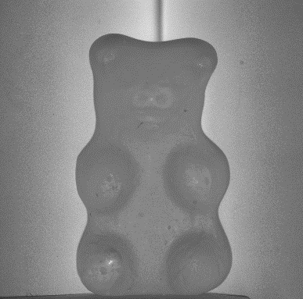
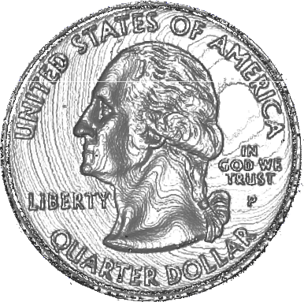
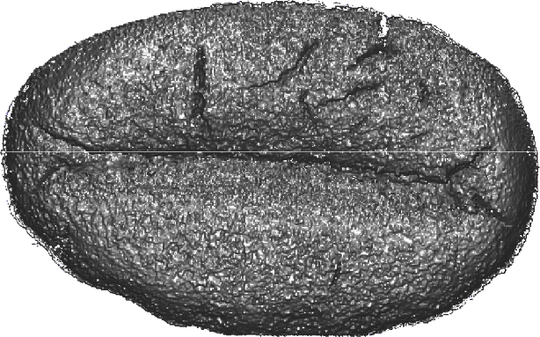
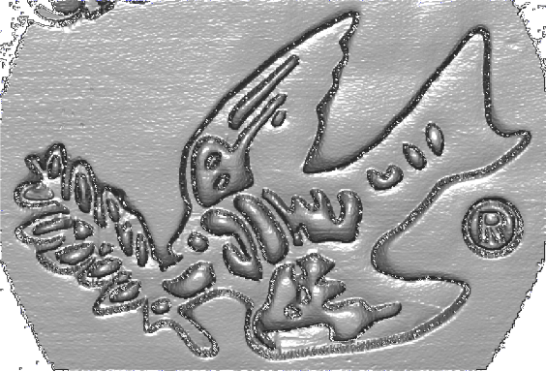
Depth scanning
depth resolution Δτ 10 μm
gummy bear and diffusers
~
coin
gnocchi
soap carving
2.5 cm
1 cm
1.5 cm
3 cm
Notes:
3D shape

Slide 26
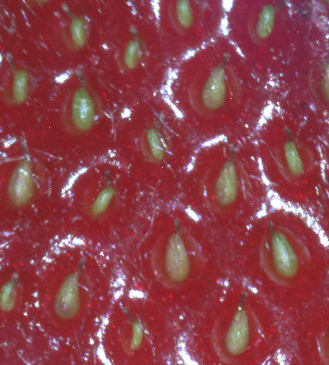
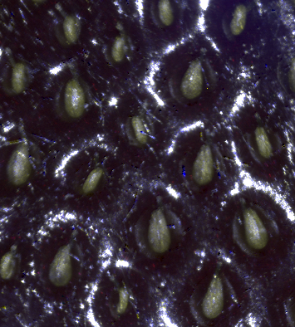
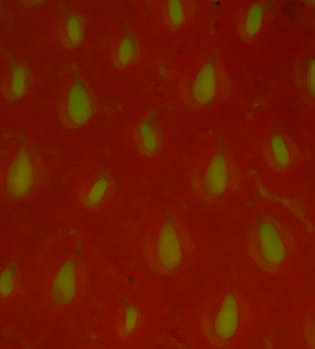
Direct-global separation
strawberry close-up
direct component
global component
Notes:
Direct-global separation

Slide 27
Decompositions using interferometry
transient imaging
Michelson interferometer
scene
wavelength
mirror
broadband point source
spatial probing + transient imaging
light source
beamsplitter
translation stage
wavelength
regular camera
broadband area source
custom mirror shapes

limited working volume (5 x 5 x 5 cm³)

micron-scale resolution

long capture times (2-8 hours per scan)

static scenes (very sensitive to vibrations)
Notes:
To conclude this section, I’ve shown that the way to do direct-only transient imaging using interferometry is as follows: Use the same Michelson intereferometer and scanning procedure as for standard transient imaging, but change the source to be an area source such as an LED. In the paper, we show that we can additionally manipulate the shape of the mirror of the Michelson interferometer, to combine transient imaging with spatial probing patterns different than those corresponding to direct-only imaging. I will also mention briefly that, in the paper we discuss the case of doing spatial probing using interferometry, though we didn’t experiment with that as it does not offer any significant resolution advantages compared to existing techniques.
And with this, I’ve covered what I set out to do at the beginning. I’ve showed you how to use interferometry to do different kinds of light transport decompositions, in terms of both pathlength and pixel-camera correspondences. As I discussed, this has the advantage that it offers a much higher resolution than other techniques. Additionally, and I didn’t discuss this in detail but it may have become apparent from the results, the method is flexible enough to also allow decomposing by color or polarization.
However, this increased resolution comes at a cost, and it’s worth mentioning here the main disadvantages of these interferometric techniques. The first is that it is impractical to work with volumes larger than 5 by 5 by 5 cm. This is analogous to conventional macrophotography, where the increase in magnification comes at the cost of a very limited field of view and depth of field.
The second disadvantage is that interferometric techniques tend to have very long scanning times, in the order of 8 hours per scan.
Finally, and as a consequence of the above, these techniques can only be applied to static scenes. In fact, combined with the very small imaging resolution, the performance of intereferometric techniques can be terribly sensitive to tiny vibrations from the environment, for example by air flow or ground vibrations.

Slide 28
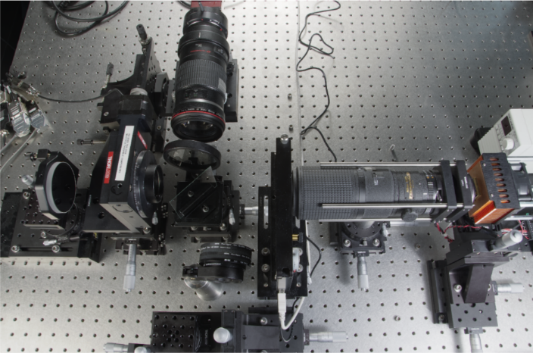
http://tinyurl.com/sig2015-transient
do it yourself!
detailed instructions for building your own interferometer
transient videos and raw data
Notes:
This brings us to the end of this talk. Before I close, I’d encourage you to visit the project website to find two things:
First, you can get detailed instructions on how to build your own interferometer, including what parts to use, how to optimize its imaging performance, and how to deal with nuisance issues such as vibrations.
And second, you can find the transient videos and raw data for all the scenes I showed here or in the paper.

Slide 29
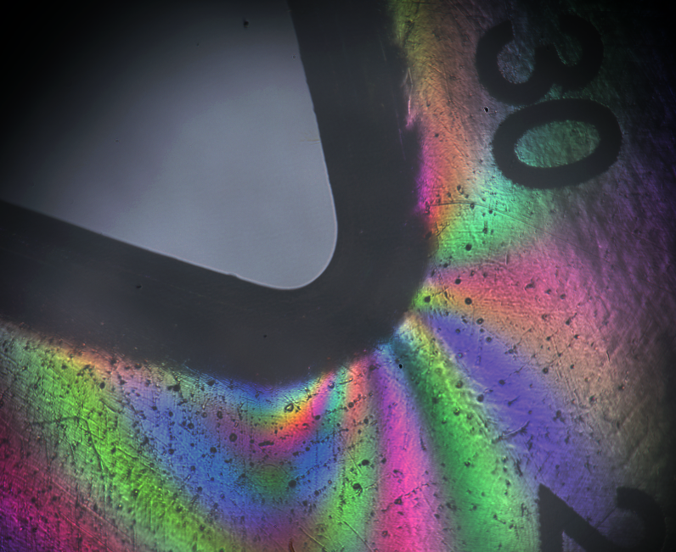
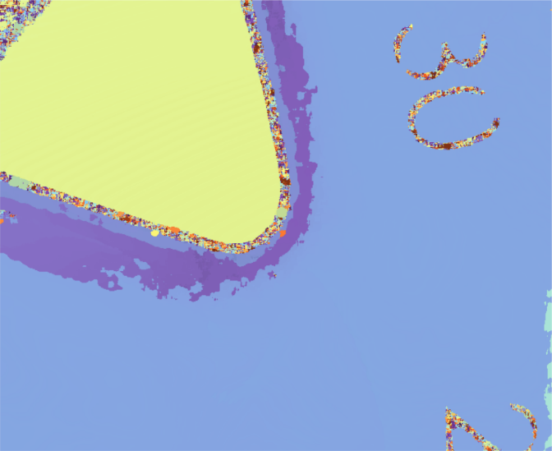
Visualizing photoelasticity
scene
detail under polarized light
low resolution Δτ = 1 mm
high resolution Δτ = 10 μm
Notes:
Here is another visualization of a material phenomenon called photoelasticity. This refers to when mechanical stresses within an ordinarily transparent and achromatic object, such as this plastic protractor, create polarization dependent variations in index of refraction. This means that, if we look at the protractor under polarized light, it has this characteristic colorful appearance.
Let's now take a transient image of this setup and visualize pathlength at each pixel. If we do this at a low resolution of 1mm, then all we can resolve is differences between paths that go straight to the mirror or travel through the protractor.
If we increase the pathlength resolution, we can resolve the fine variations in pathlength due to photoelasticity.

