Slide 1

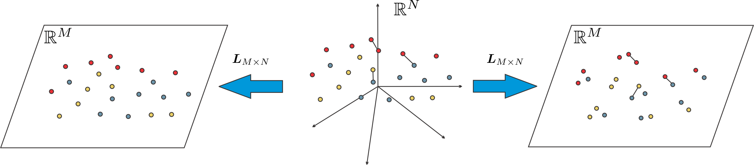
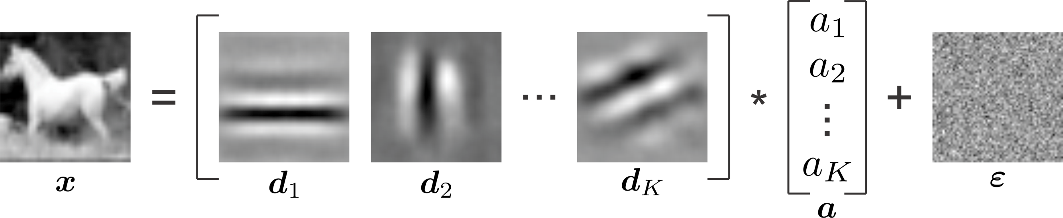
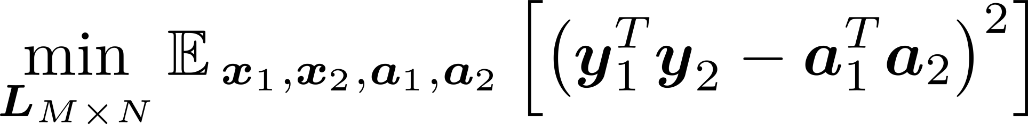
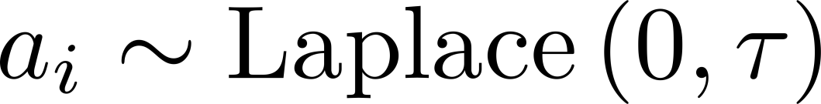
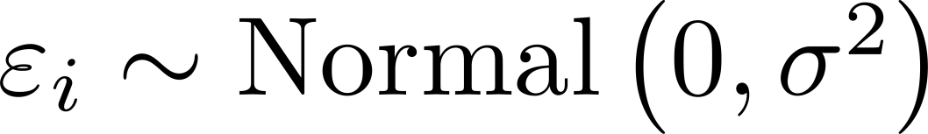
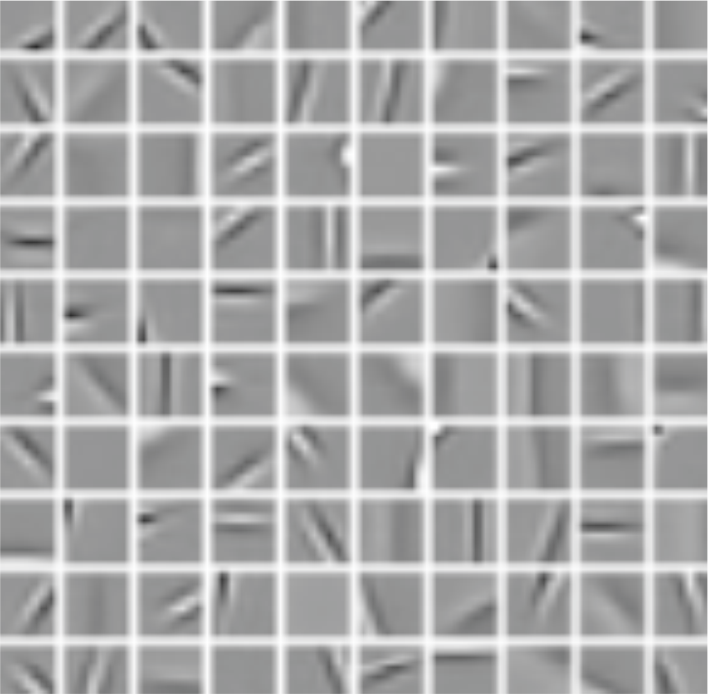
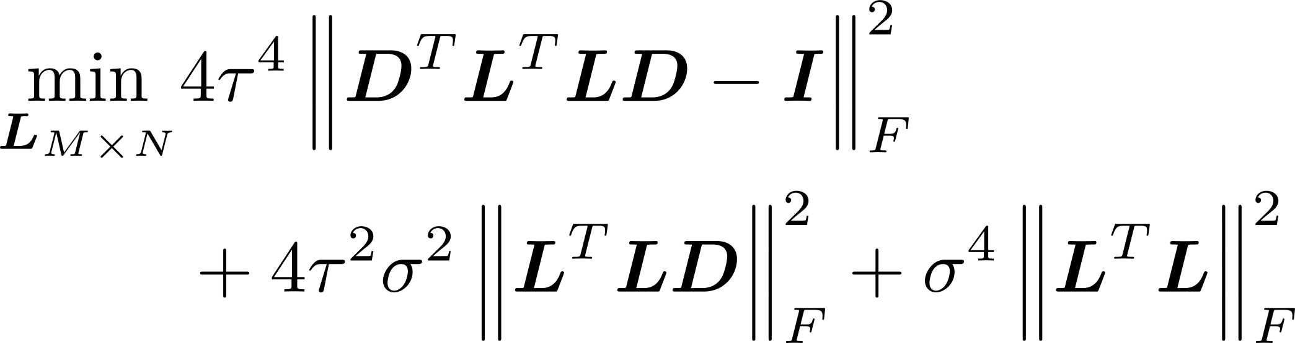

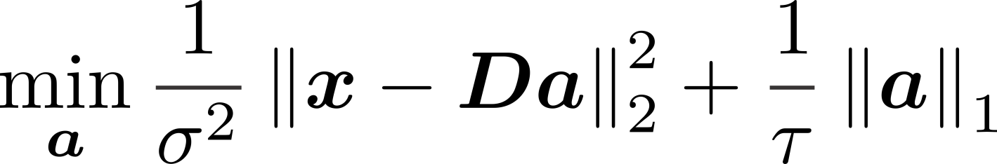
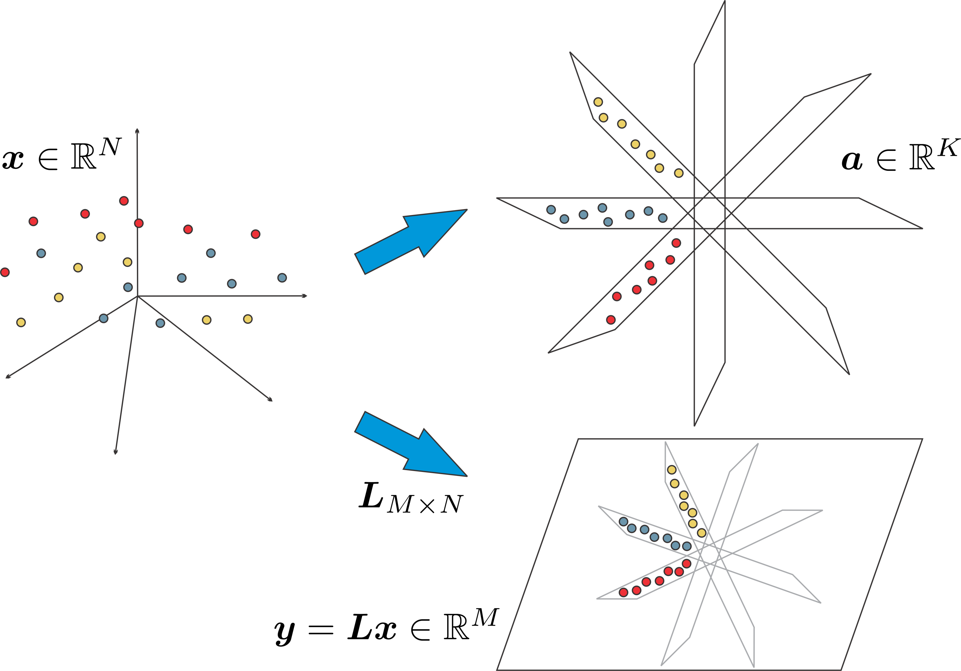



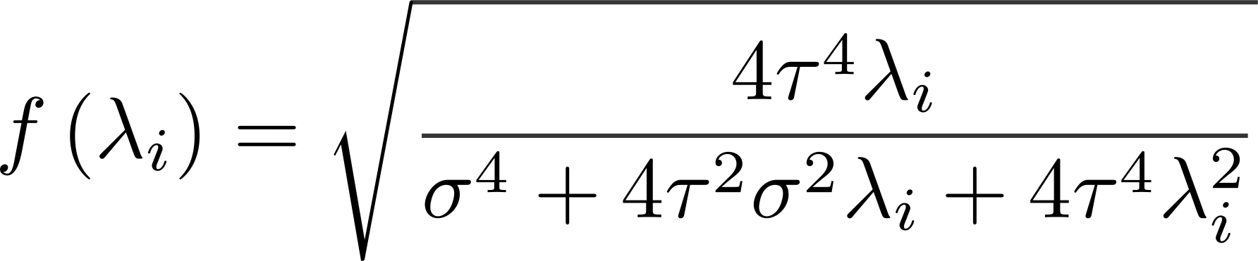
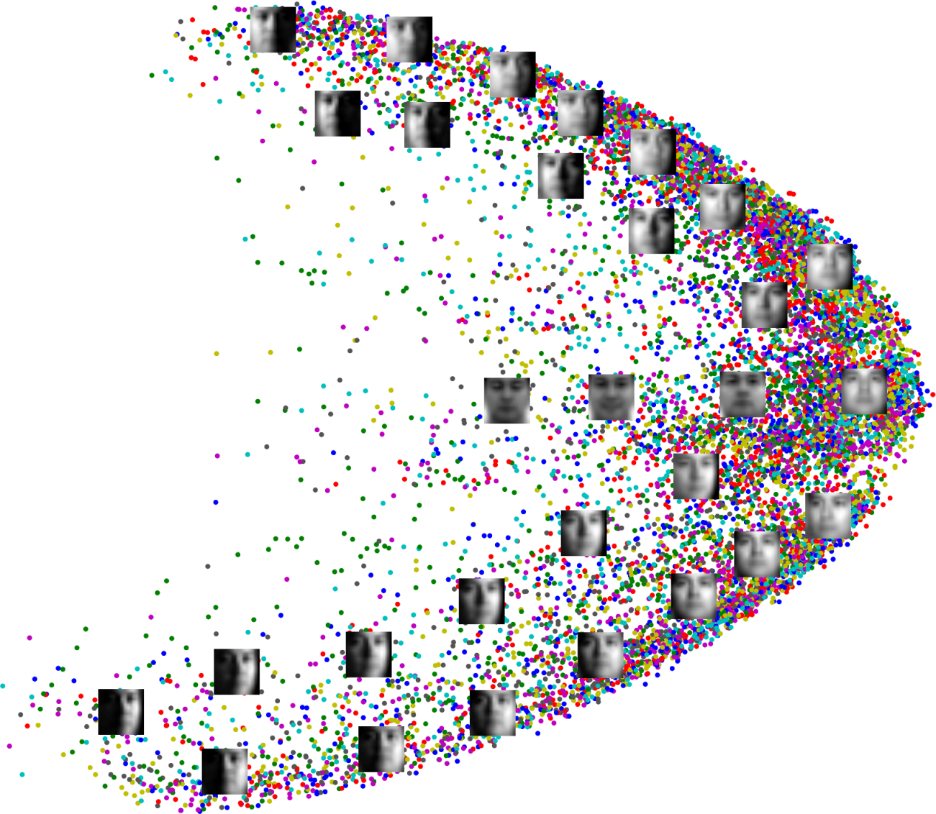
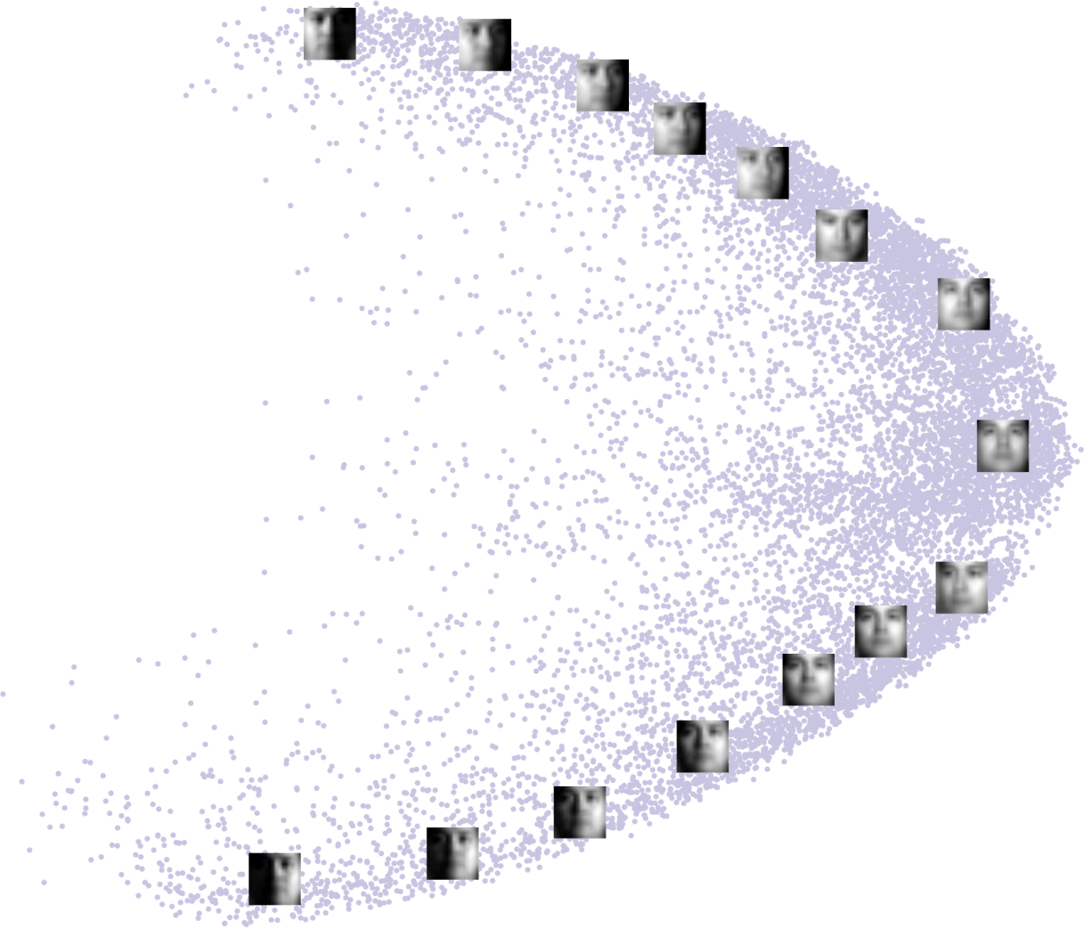
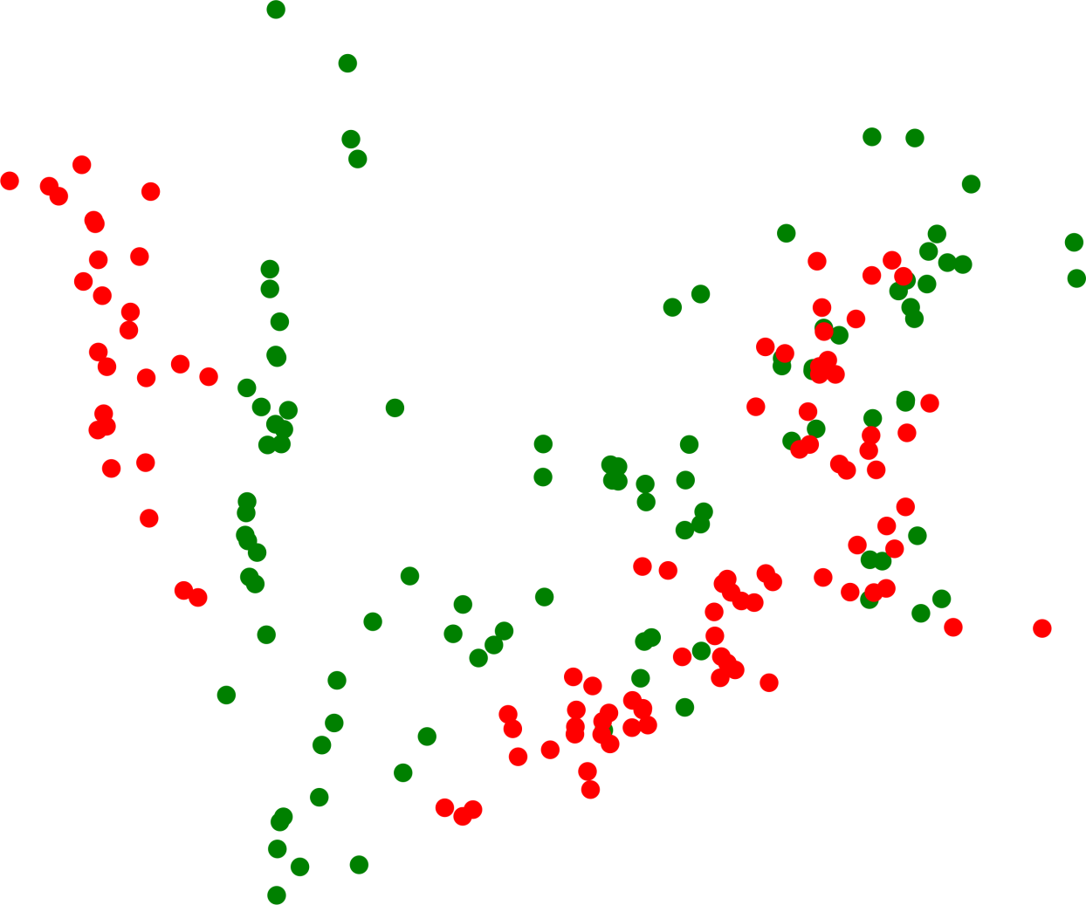
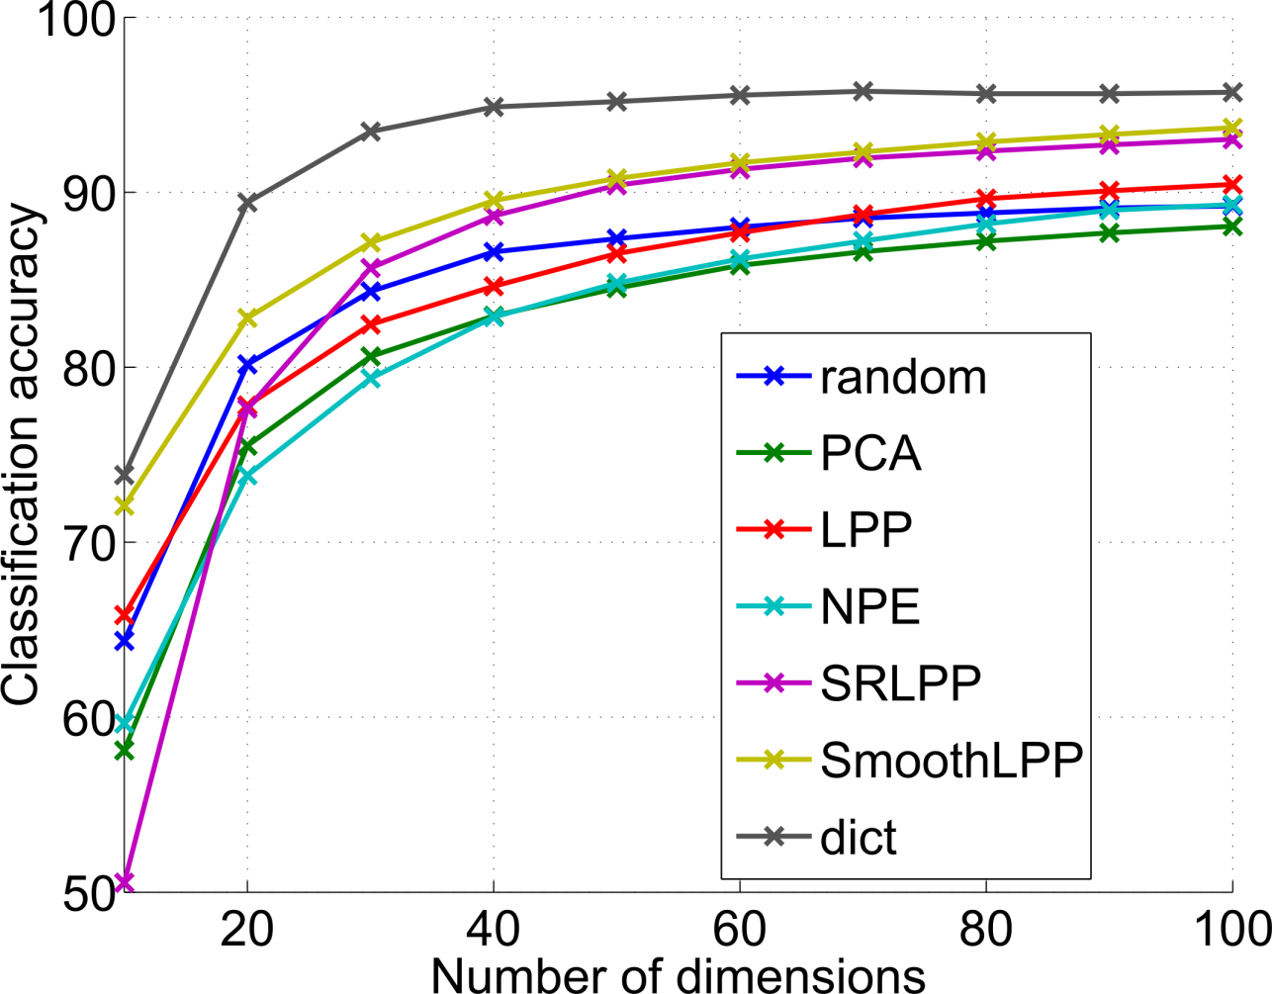
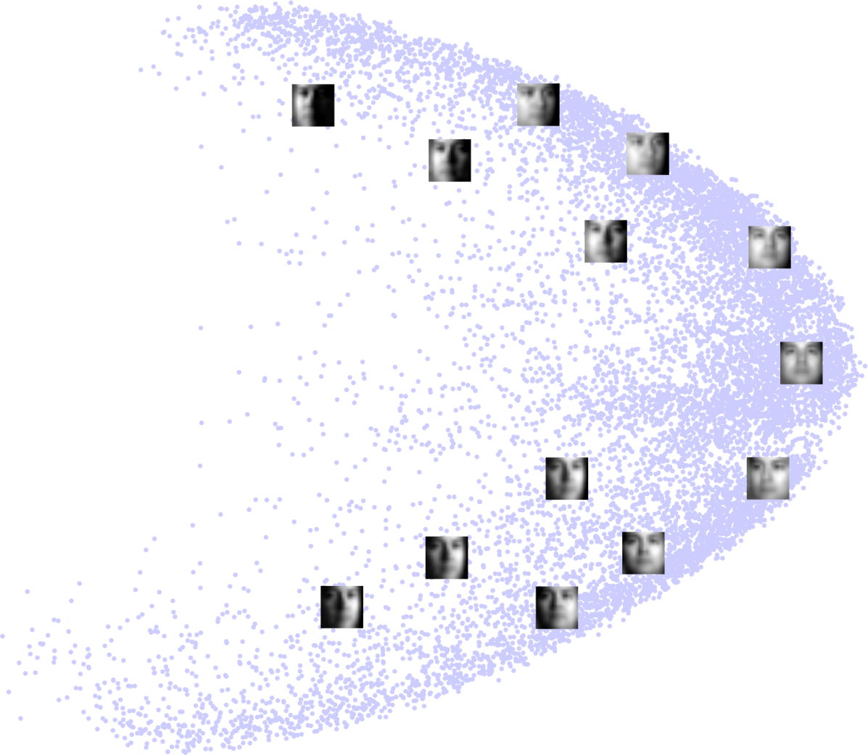
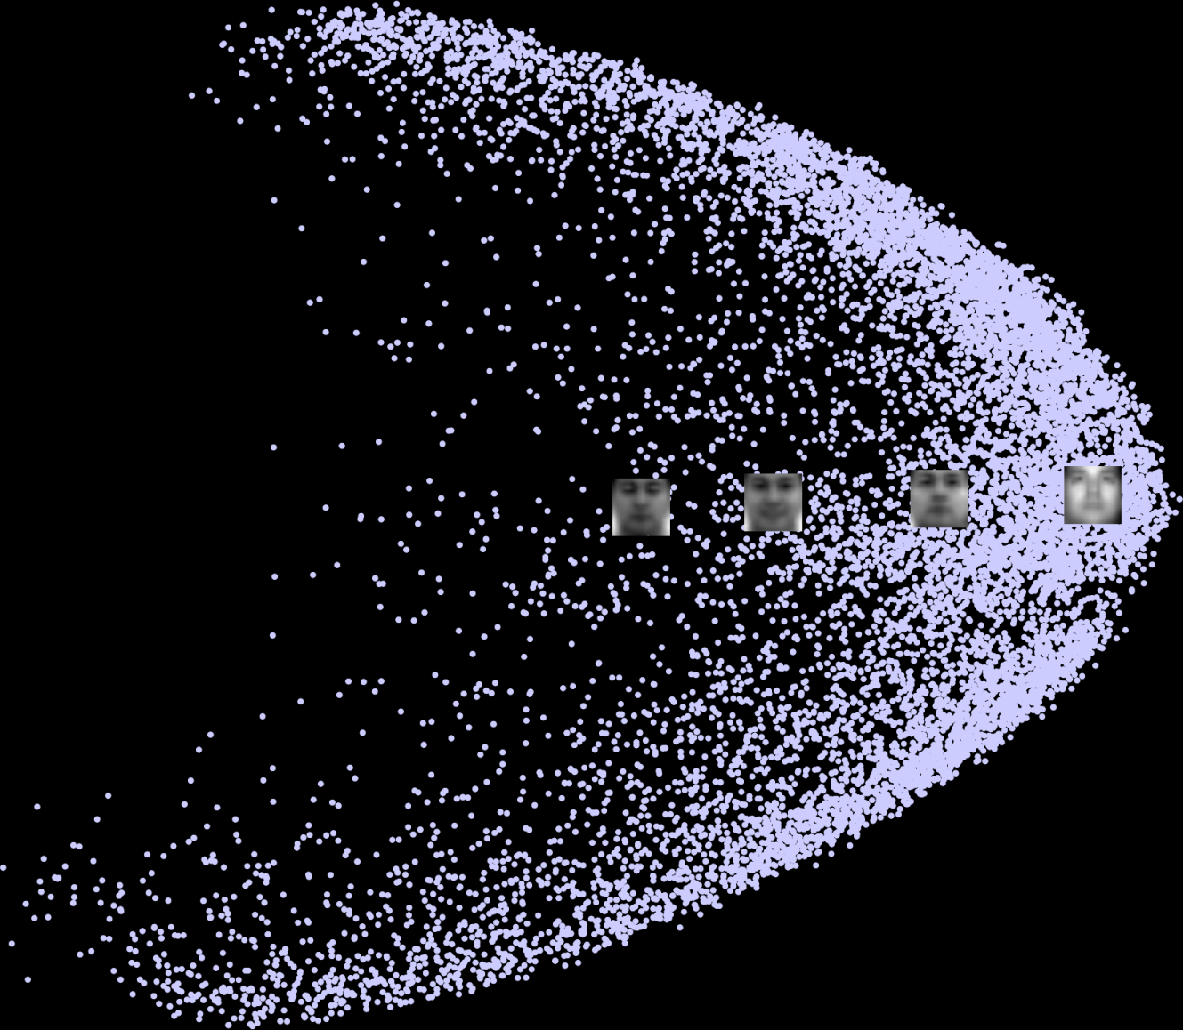
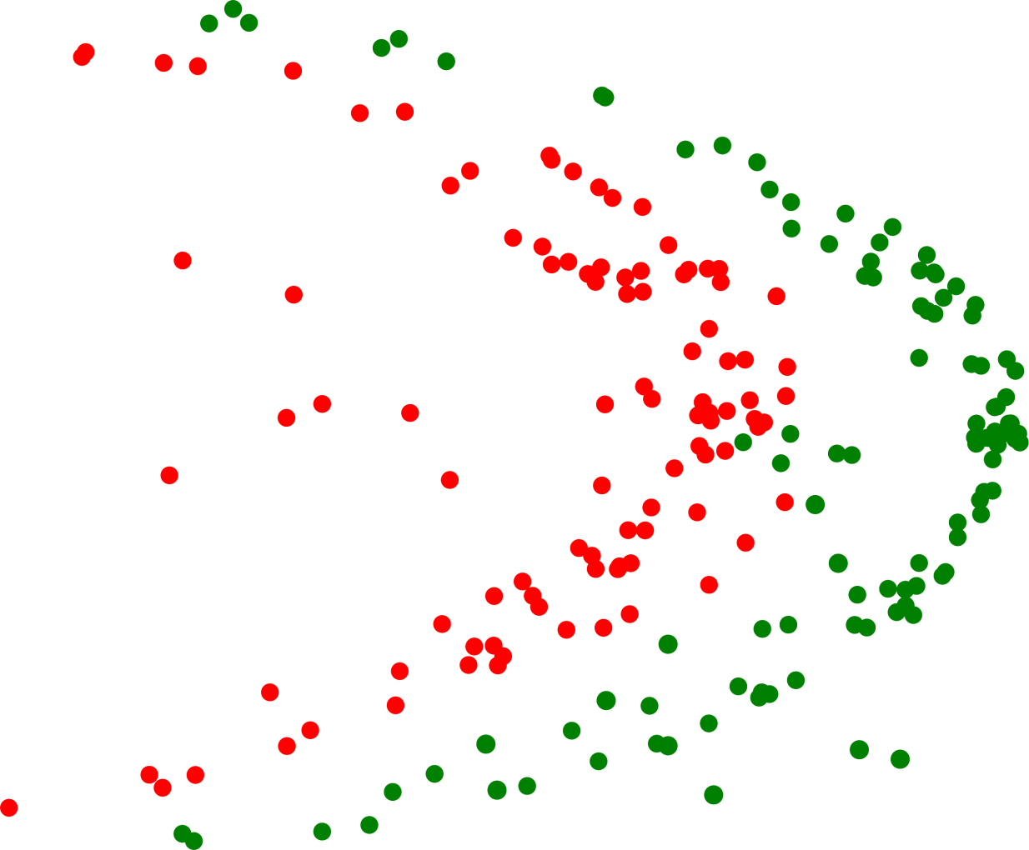
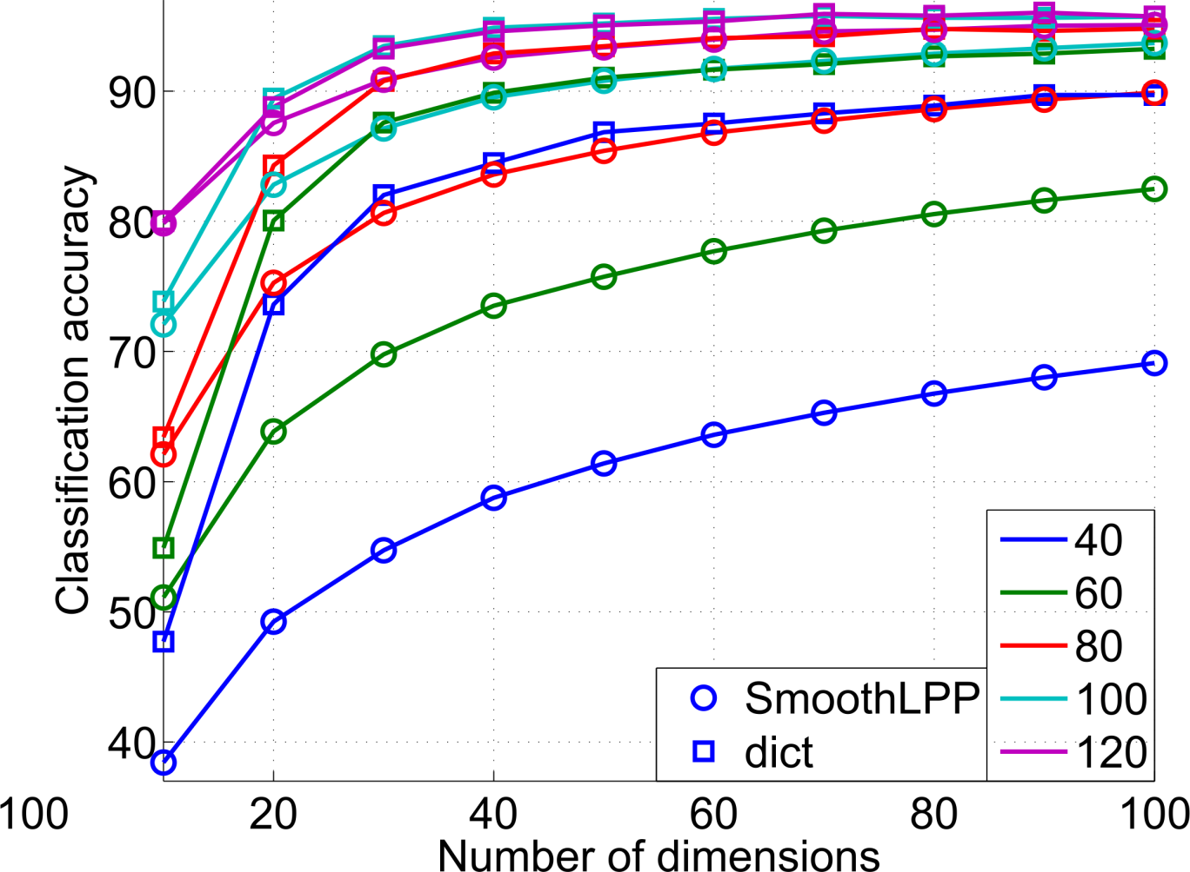
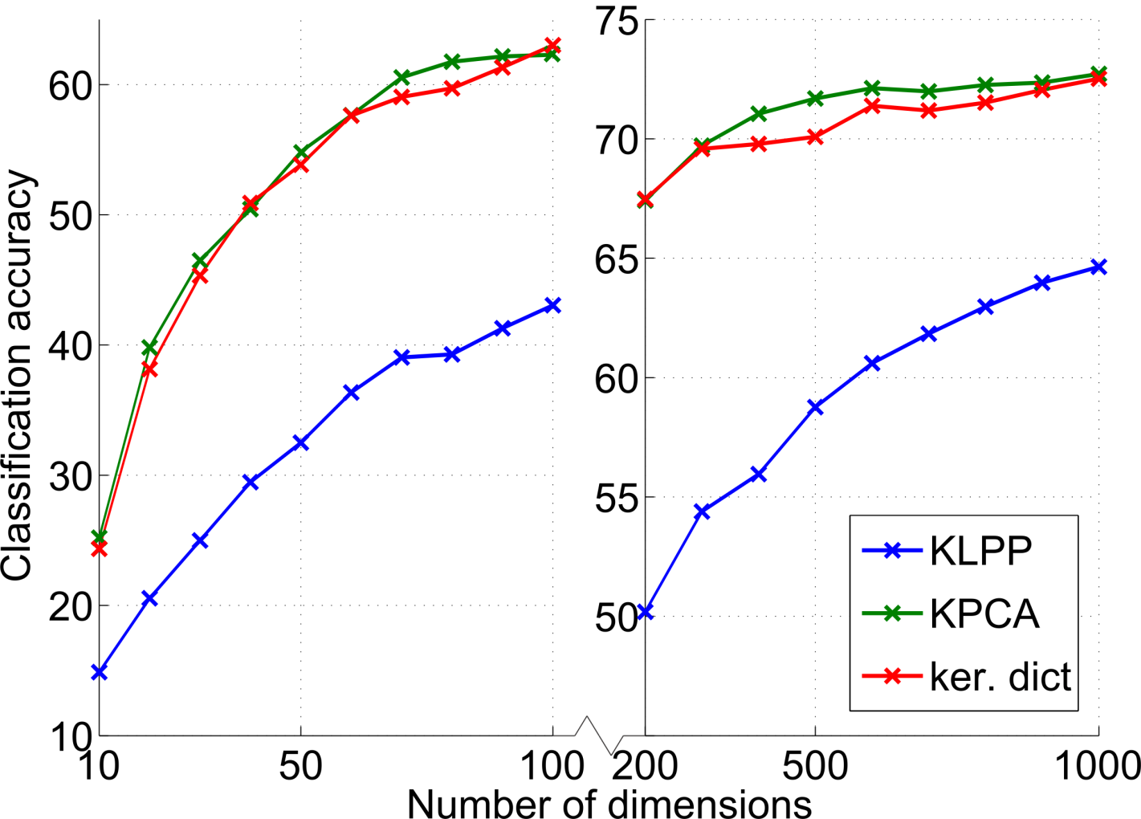
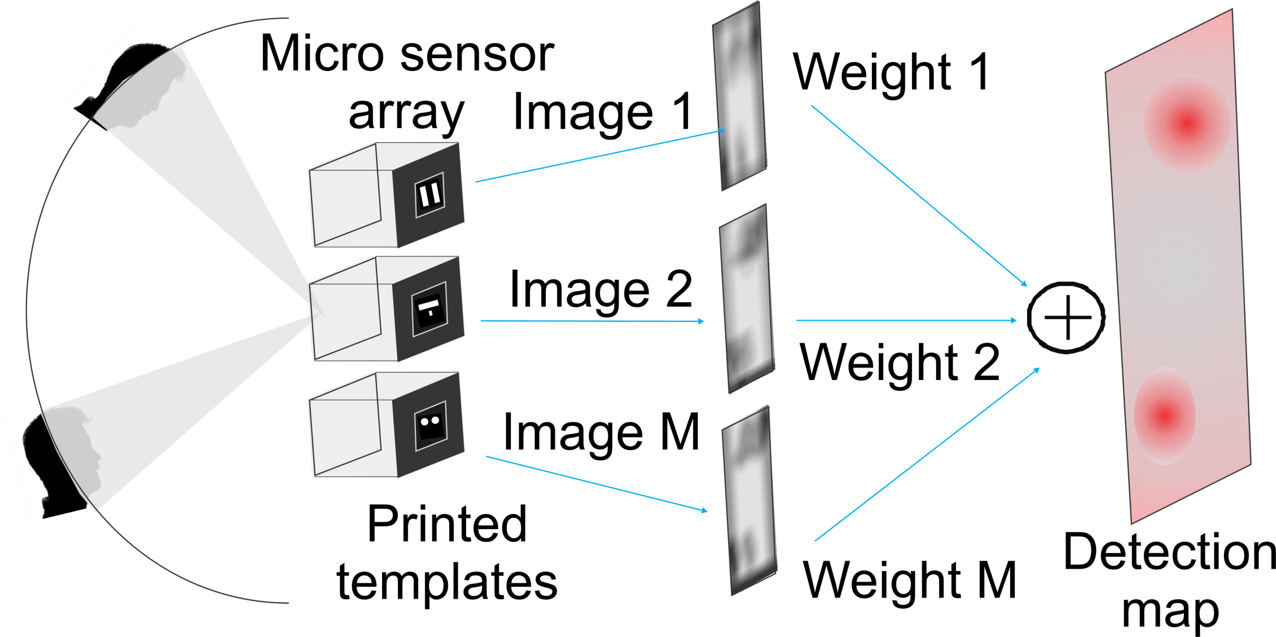
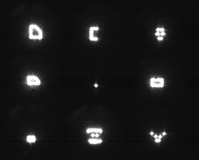
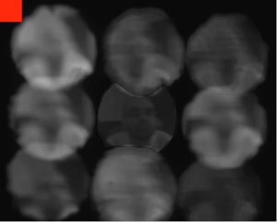
Linear Dimensionality Reduction Using
the Sparse Linear Model
Ioannis Gkioulekas and Todd Zickler
Harvard School of Engineering and Applied Sciences
Unsupervised Linear Dimensionality Reduction
Principal Component Analysis:
preserve global structure
Locality Preserving Projections:
preserve local distances
Challenge: Euclidean structure of input space not directly useful
Sparse Linear Model
Formulation
Generative
model
Preservation of inner products in expectation:
Equivalent to, in the case of the sparse linear model:
Data-adaptive
(ovecomplete)
dictionary
MAP inference: lasso
(convex relaxation
of sparse coding)
Global minimizer:
Our Approach
where and are the top M eigenpairs of and
sparse
coding
Similar to performing PCA on the dictionary instead of the training samples. See paper for:
kernel extension (extension of model to Hilbert spaces, representer theorem);
relations to compressed sensing (approximate minimization of mutual incoherence).
Recognition Experiments
Linear Case: Facial Images (CMU PIE)
LPP
illumination
Visualization
Proposed
pose
expression
Kernel Case: Caltech 101
Application: low-power sensor
Recognition and Unsupervised Clustering Experiments
Method | Accuracy
KPCA + k-means | 62.17%
KLPP + spectral clustering | 69.00%
Proposed + k-means | 72.33%
References
Face detection
with 8 printed
templates
and SVM
[1] X. He and P. Niyogi. Locality Preserving Projections. NIPS, 2003.
[2] M.W. Seeger. Bayesian inference and optimal design for the sparse linear model. JMLR, 2008.
[3] H. Lee, A. Battle, R. Raina, and A.Y. Ng. Efficient sparse coding algorithms. NIPS, 2007.
[4] R.G. Baraniuk, V. Cevher, and M.B. Wakin. Low-Dimensional Models for Dimensionality Reduction and Signal Recovery: A Geometric Perspective. Proceedings of the IEEE, 2010.
[5] P. Gehler and S. Nowozin. On feature combination for multiclass object classification. ICCV, 2009.
[6] S.J. Koppal, I. Gkioulekas, T. Zickler, and G.L. Barrows. Wide-angle micro sensors for vision on a tight budget. CVPR, 2011.

