Slide 1
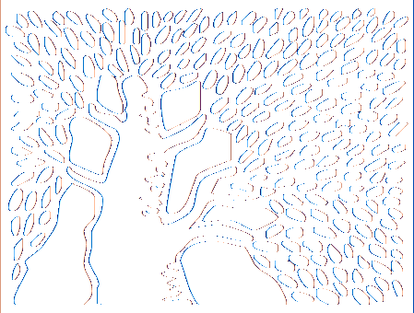
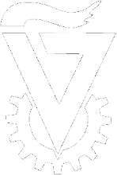
An evaluation of computational imaging techniques for inverse scattering
Ioannis Gkioulekas¹
Anat Levin^{2,3}
Todd Zickler¹
¹Harvard SEAS
²Weizmann Institute
³Technion
Notes:
Thanks for the introduction.

Slide 2
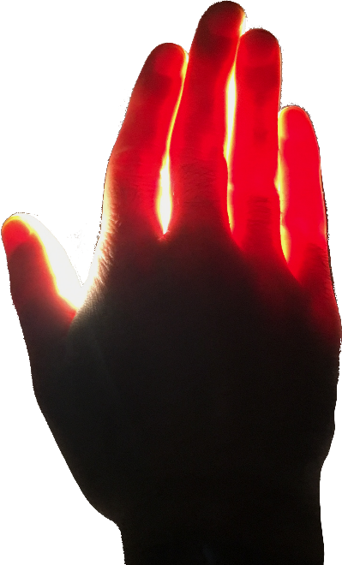
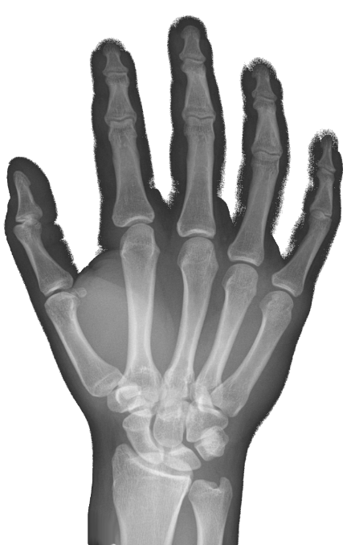
Looking inside stuff
visible
making sense of this
source
sensor
X-ray
EM spectrum
Notes:
2: To tease you about scattering, I made this collage to show you that scattering materials are everywhere. Our skin and most biological tissues have scattering. And so do jewels and natural minerals.
Leaves, fruits and vegetables, and most of the stuff we eat are made of scattering materials
We see scattering in chemicals ranging from soap and wax, to cosmetics, to industrial coating powers.
And material scientists are continually developing structures that exhibit new and useful forms of scattering behavior.
Because of the ubiquitity of these materials, several sciences have been studying scattering for several decades, from physics biology, and chemistry, to computer graphics and vision.

Slide 3
New imaging capabilities
selecting which photons to measure
conventional imaging
structured light
long
short
transient imaging
combinations
Notes:
2: To tease you about scattering, I made this collage to show you that scattering materials are everywhere. Our skin and most biological tissues have scattering. And so do jewels and natural minerals.
Leaves, fruits and vegetables, and most of the stuff we eat are made of scattering materials
We see scattering in chemicals ranging from soap and wax, to cosmetics, to industrial coating powers.
And material scientists are continually developing structures that exhibit new and useful forms of scattering behavior.
Because of the ubiquitity of these materials, several sciences have been studying scattering for several decades, from physics biology, and chemistry, to computer graphics and vision.

Slide 4
Problem statement and contributions
heterogeneous inverse scattering by appearance matching
source
sensor
optimization problem
min ǁ - image(m) ǁ²
material m(x)
m(x)
Are there ambiguities between the unknowns?
How do we solve this optimization problem?
Notes:
2: To tease you about scattering, I made this collage to show you that scattering materials are everywhere. Our skin and most biological tissues have scattering. And so do jewels and natural minerals.
Leaves, fruits and vegetables, and most of the stuff we eat are made of scattering materials
We see scattering in chemicals ranging from soap and wax, to cosmetics, to industrial coating powers.
And material scientists are continually developing structures that exhibit new and useful forms of scattering behavior.
Because of the ubiquitity of these materials, several sciences have been studying scattering for several decades, from physics biology, and chemistry, to computer graphics and vision.

Slide 5
Ambiguities between unknowns?
transient video
…
t = 10 fs
t = 20 fs
t = 30 fs
t = 40 fs
t = 50 fs
uniquely determines deepest layer
recursion: uniquely determines entire volume
source + sensor
deepest layer reached after t = 40 fs travel time
Notes:
2: To tease you about scattering, I made this collage to show you that scattering materials are everywhere. Our skin and most biological tissues have scattering. And so do jewels and natural minerals.
Leaves, fruits and vegetables, and most of the stuff we eat are made of scattering materials
We see scattering in chemicals ranging from soap and wax, to cosmetics, to industrial coating powers.
And material scientists are continually developing structures that exhibit new and useful forms of scattering behavior.
Because of the ubiquitity of these materials, several sciences have been studying scattering for several decades, from physics biology, and chemistry, to computer graphics and vision.

Slide 6
Problem statement and contributions
heterogeneous inverse scattering by appearance matching
source
sensor
optimization problem
min ǁ - image(m) ǁ²
material m(x)
m(x)
Are there ambiguities between the unknowns?
provable uniqueness for certain imaging types
How do we solve this optimization problem?
Notes:
2: To tease you about scattering, I made this collage to show you that scattering materials are everywhere. Our skin and most biological tissues have scattering. And so do jewels and natural minerals.
Leaves, fruits and vegetables, and most of the stuff we eat are made of scattering materials
We see scattering in chemicals ranging from soap and wax, to cosmetics, to industrial coating powers.
And material scientists are continually developing structures that exhibit new and useful forms of scattering behavior.
Because of the ubiquitity of these materials, several sciences have been studying scattering for several decades, from physics biology, and chemistry, to computer graphics and vision.

Slide 7
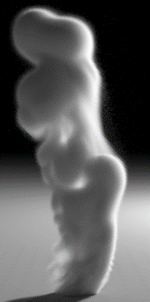
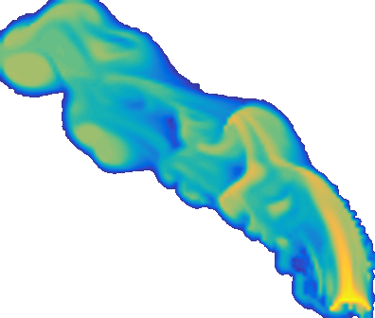
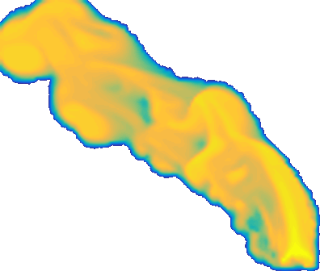
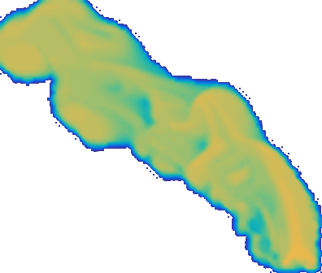
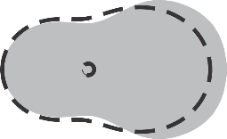
How do we do optimization?
10⁴ unknowns
source
sensor
large-scale simulation:
20 thousand cores
1 million measurements
10 thousand unknowns
optimization problem
min ǁ - image(m) ǁ²
material m(x)
m(x)
smoke volume
density
albedo
phase function
very non-linear
~
∂image(m)
∂m
stochastic gradient descent
σ (x)
volumetric density
material m (x)
while (not converged)
Monte Carlo rendering
a
θ
scattering albedo
a (x)
~
σ
f_{s}(θ)
∂loss(m)
∂m
f_{s} (θ,x)
phase function
update m using
material m+∂m
Notes:
2: To tease you about scattering, I made this collage to show you that scattering materials are everywhere. Our skin and most biological tissues have scattering. And so do jewels and natural minerals.
Leaves, fruits and vegetables, and most of the stuff we eat are made of scattering materials
We see scattering in chemicals ranging from soap and wax, to cosmetics, to industrial coating powers.
And material scientists are continually developing structures that exhibit new and useful forms of scattering behavior.
Because of the ubiquitity of these materials, several sciences have been studying scattering for several decades, from physics biology, and chemistry, to computer graphics and vision.

Slide 8
Problem statement and contributions
heterogeneous inverse scattering by appearance matching
source
sensor
optimization problem
min ǁ - image(m) ǁ²
material m(x)
m(x)
http://tinyurl.com/InvTransient
Are there ambiguities between the unknowns?
provable uniqueness for certain imaging types
How do we solve this optimization problem?
scalable, general, physically-accurate algorithm
empirical evaluation of imaging configurations
Notes:
2: To tease you about scattering, I made this collage to show you that scattering materials are everywhere. Our skin and most biological tissues have scattering. And so do jewels and natural minerals.
Leaves, fruits and vegetables, and most of the stuff we eat are made of scattering materials
We see scattering in chemicals ranging from soap and wax, to cosmetics, to industrial coating powers.
And material scientists are continually developing structures that exhibit new and useful forms of scattering behavior.
Because of the ubiquitity of these materials, several sciences have been studying scattering for several decades, from physics biology, and chemistry, to computer graphics and vision.

