Slide 1
Focal Flow
Measuring Distance and Velocity with Defocus and Differential Motion
E. Alexander, Qi Guo,
S.J. Koppal, S.J. Gortler,
& T. Zickler

Slide 2

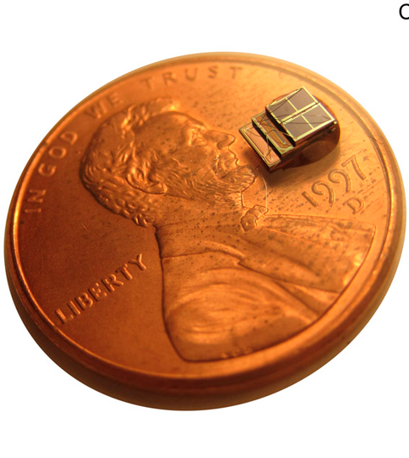
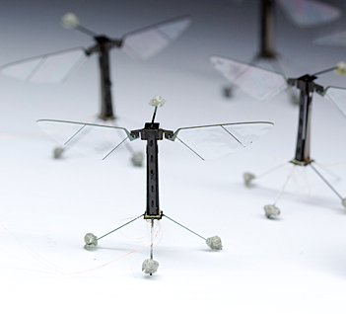
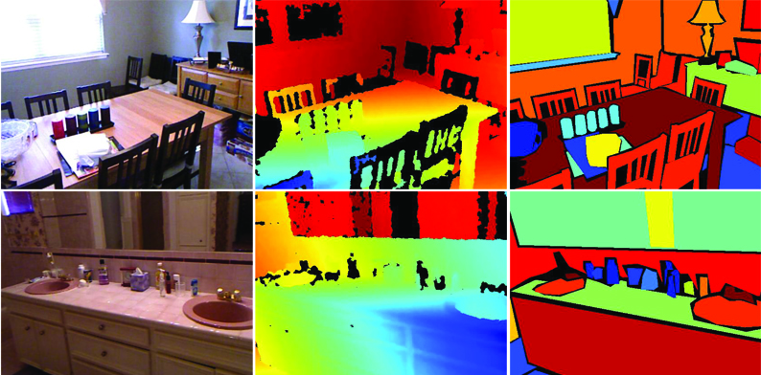

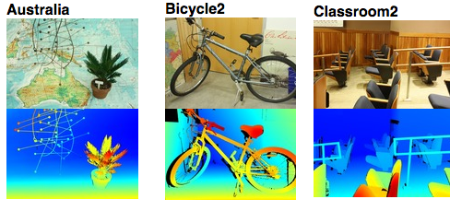
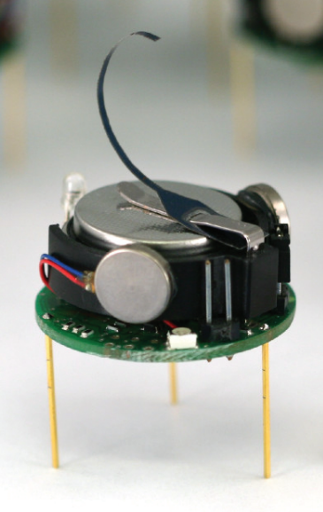

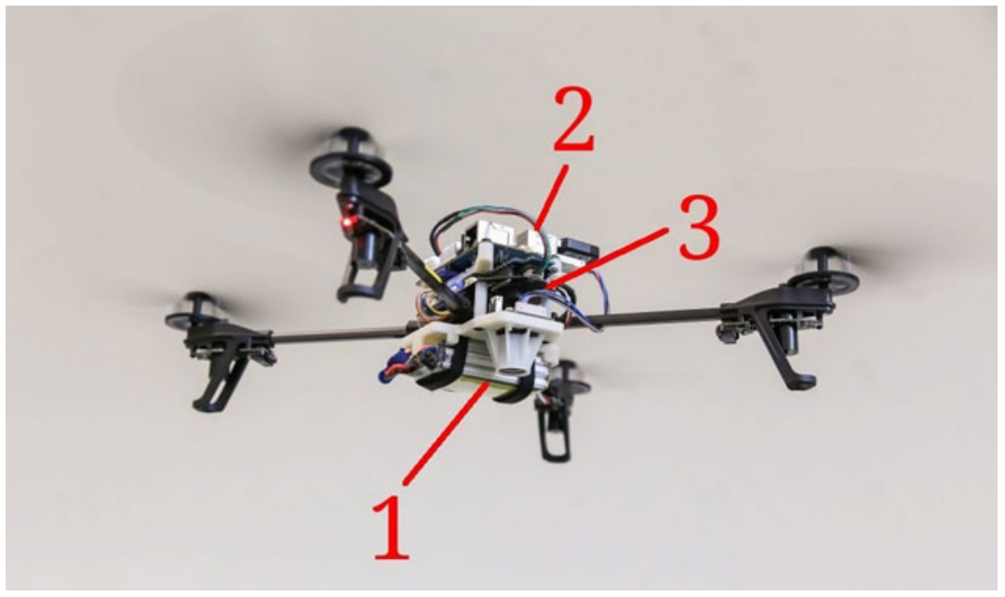

Low-level vision on various platforms
[Chen et al. 10]
[Butler et al. 12]
[Schöps et al. 14]
[Silverman et al. 12]
[Ma et al. 13]
[Scharstein et al. 14]
[Menze & Geiger 15]
[Faessler et al. 15]
[Rubenstein et al. 14]
Power and size
~W
~mW
Notes:
As a community we have done quite well at designing low-level vision systems that can accurately infer scene properties like depth and 3D scene velocity. This is particularly true for large scale systems, which are optimized for accuracy on big datasets, and which are not strongly concerned about power consumption at runtime.
We are even doing well inferring depth, geometry, and velocity on embedded platforms like these, where peak power budgets are on the order of Watts.
But on the horizon there is a new generation of micro-scale platforms, like swarm robots, microUAVs, and self-sustaining sensor networks. The power budgets of these devices are hundreds to millions of times smaller than the embedded systems, and are measured in milliwatts or even fractions of microwatts. --It is not yet clear what visual sensing can accomplish at these scales.

Slide 3
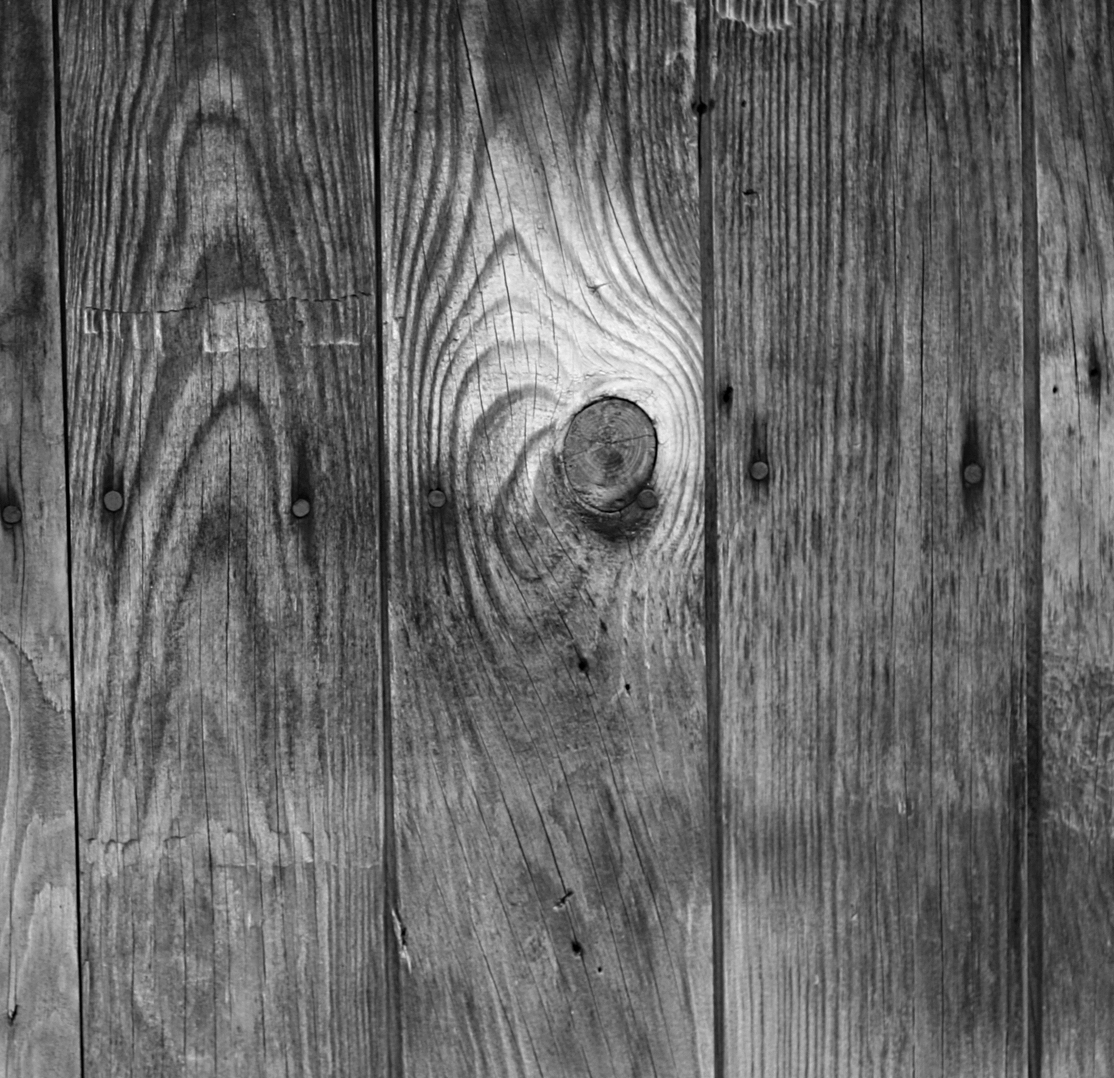

Focal Flow
passive
        no light emission
        no camera actuation
few operations
scene information
Scene Depth & 3D Velocity,
per pixel
photo: lostandtaken
thin lens +
passive filter
per-patch
4x4 linear system
Notes:
Today I’m going to show you focal flow, a new, potentially highly efficient way to measure low-level scene information through the combination of optical defocus and differential motion.
We consider a simple camera that collects images of a moving scene.
From this video, we will take useful scene measurements using very few adds and multiplies.
Additionally, the camera is completely passive, with fixed and calibrated parameters.
I’m going to show you that we can take advantage of the motion of these micro-scale platforms and the scenes that they observe. And with just a thin lens and an attenuating filter at the aperture,
there exists a unique linear constraint on scene depth and 3D velocity, so that a 4x4 linear system can be solved at each image patch
for depth and velocity at the back-projection of the patch’s center.

Slide 4
Outline
1. focal flow equation
        independent of texture
        unique constraint: Gaussian blur
2. experiments
Notes:
Most of the talk will be used to introduce this linear constraint.
At a given pixel, we only compute a few derivatives:
-- the first derivatives in horizontal and vertical directions <highlight these in blue>
-- a sum of these, weighted by the pixel location on the image plane, for the directional derivative in the radial direction <highlight this in blue>
-- a rotationally-symmetric second derivative, the image Laplacian <highlight this in blue>
-- and the partial derivative in time <highlight this in blue>
<Z, Xdot,Ydot,Zdot shows up> These simple measurements, computed at single pixel, constrain a vector that is one-to-one with the depth and 3D scene velocity at the back-projection of that pixel.
<independent of texture shows up> I will show you that this constraint is valid regardless of the texture in the scene. Not only that, but that under radially symmetric optics it is the only such constraint, and it requires that the blur kernels of the camera be Gaussian.
I will then show some preliminary experimental results, demonstrating the effectiveness of this new cue in practice.

Slide 5

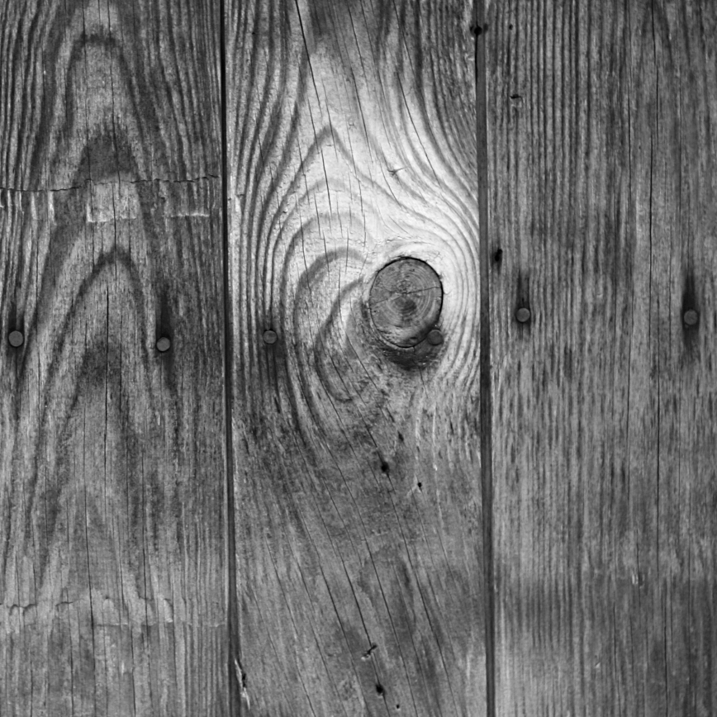
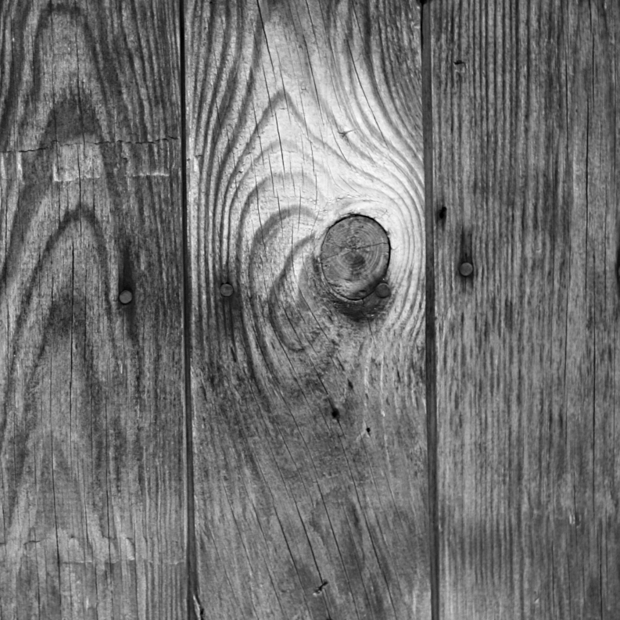
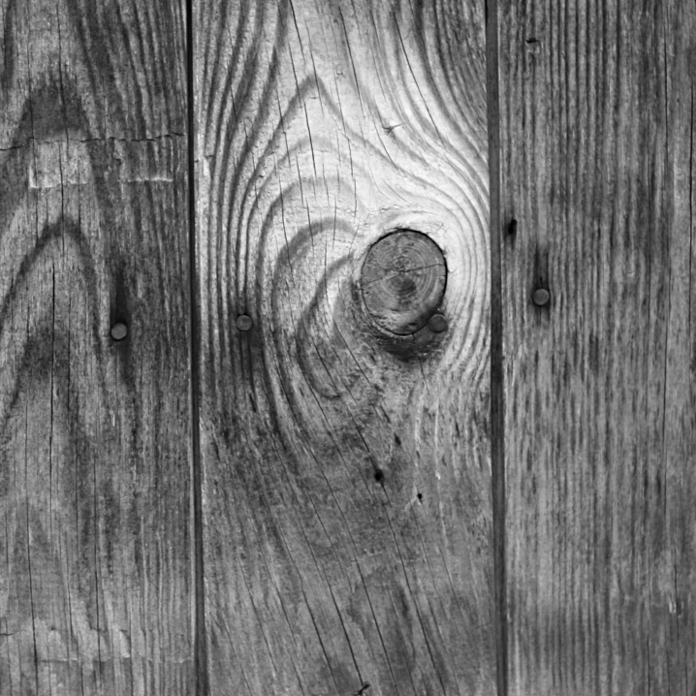
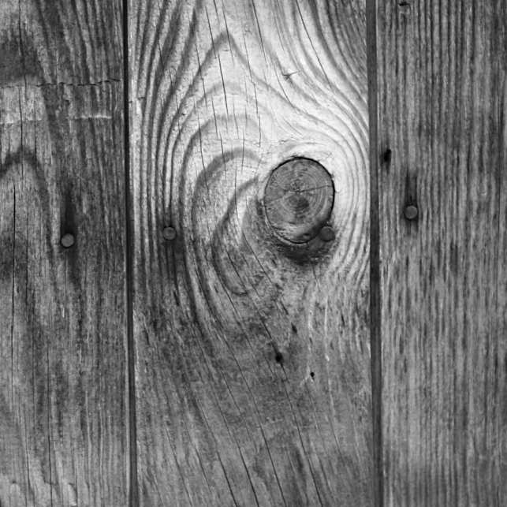
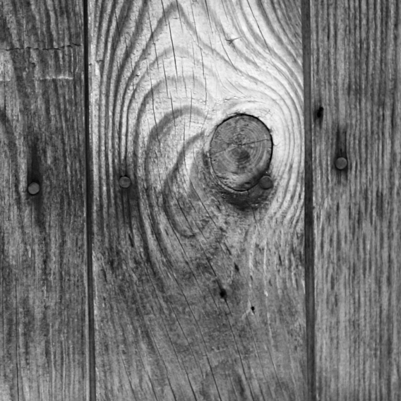
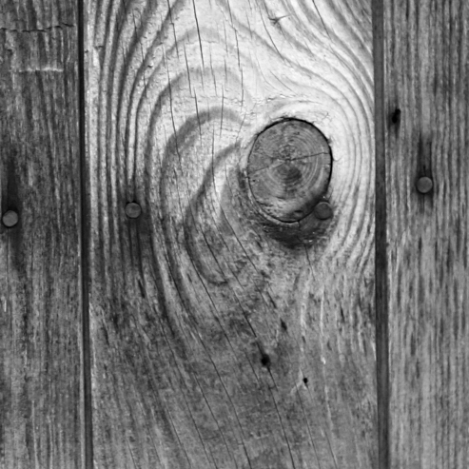
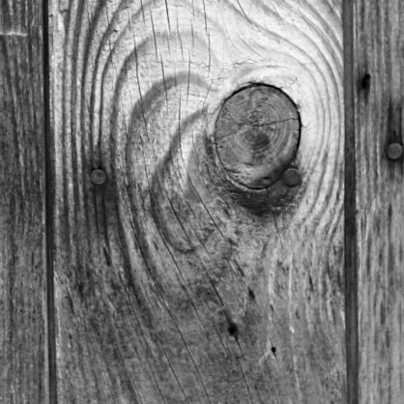
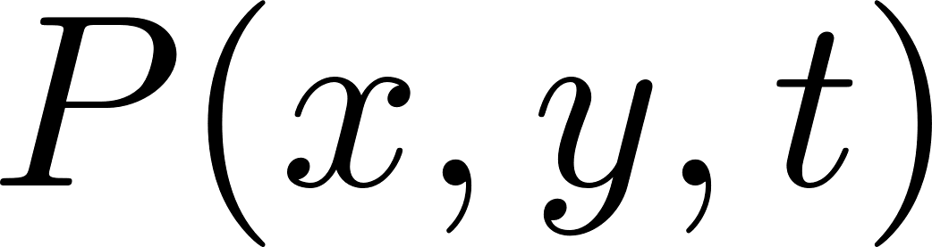
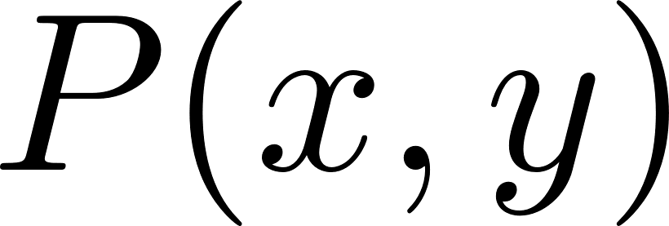
Notes:
To begin, we review differential optical flow. Imagine a pinhole camera, observing a textured plane.
It collects an image P, which is a scaled version of the texture.
If the plane approaches the pinhole camera, we observe image expansion as a result,

Slide 6
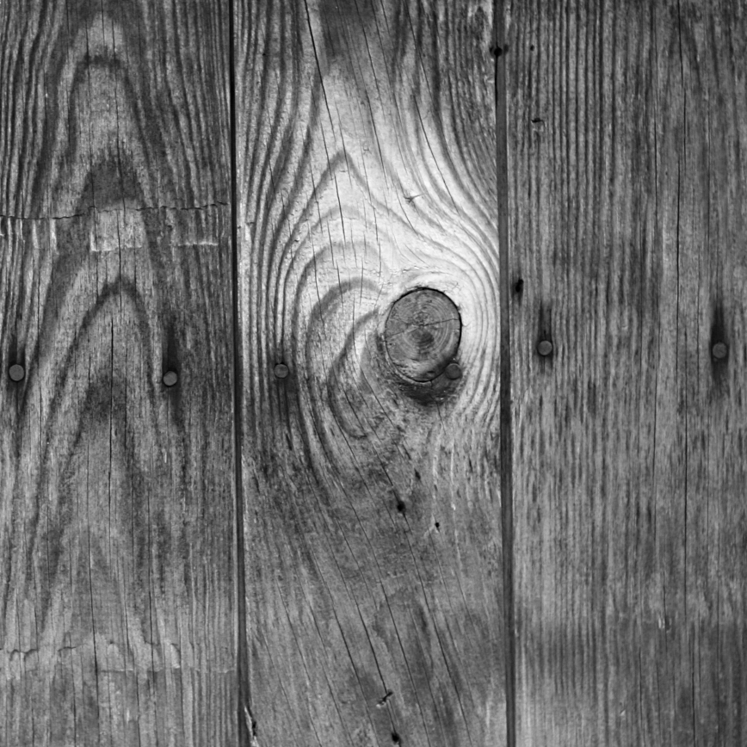
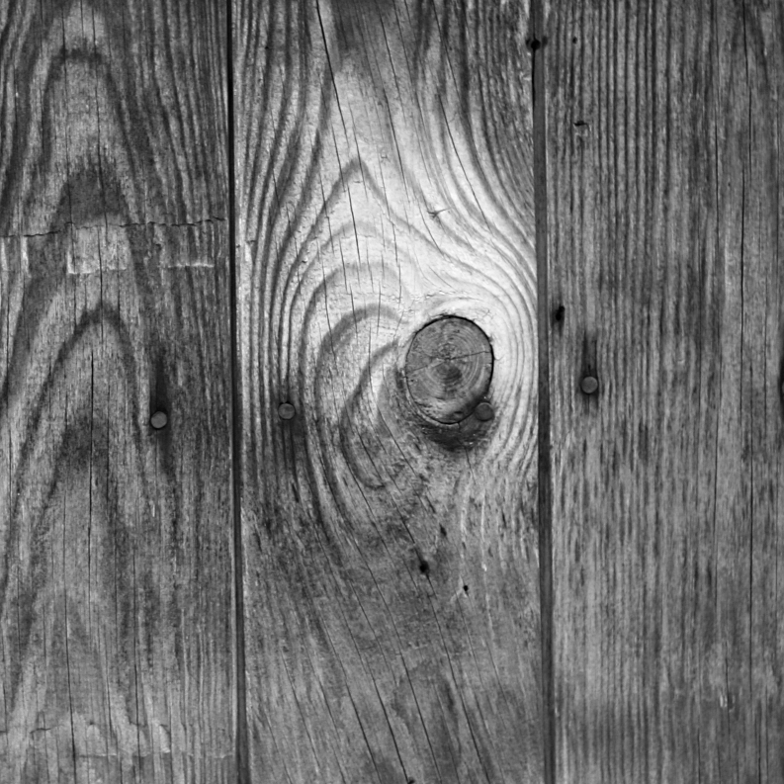
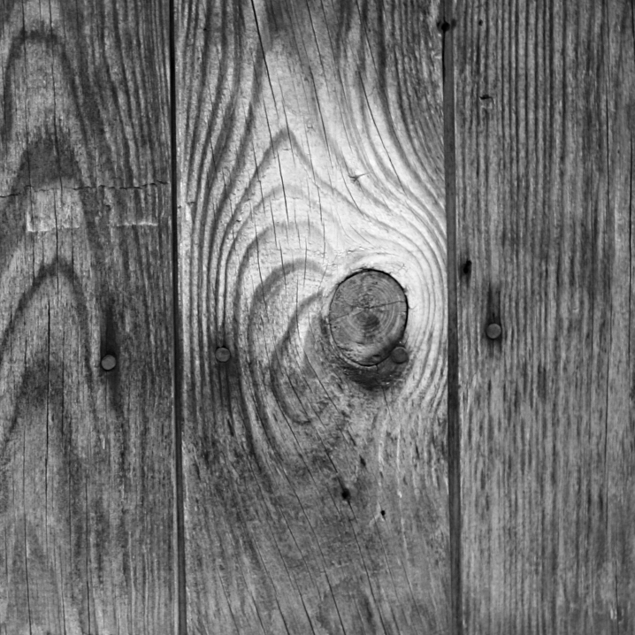
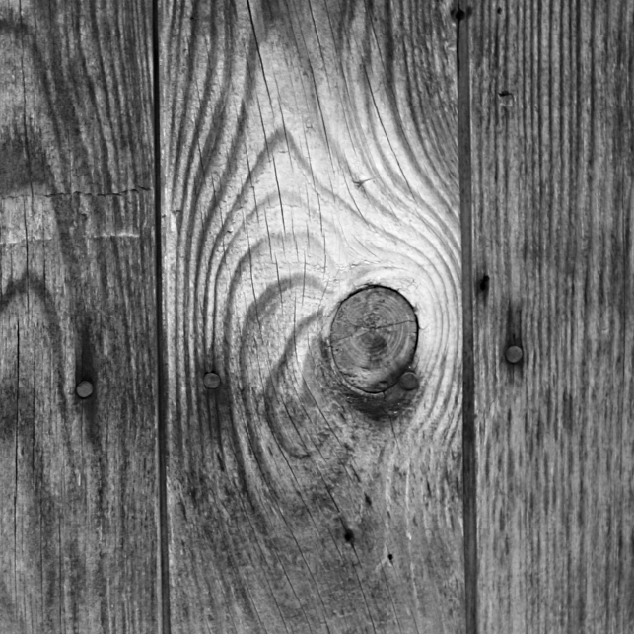
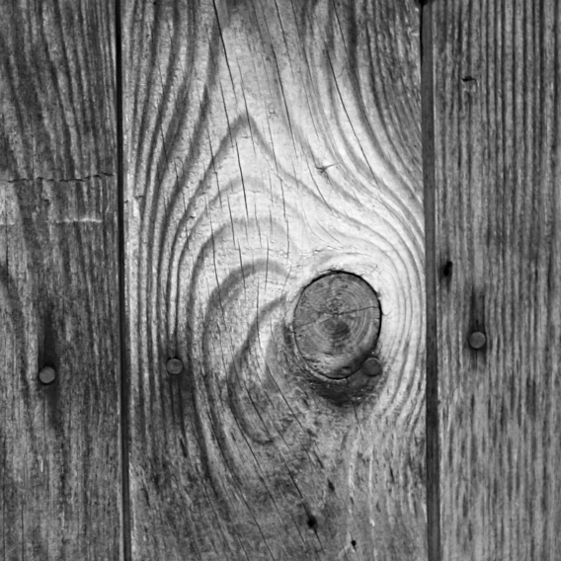
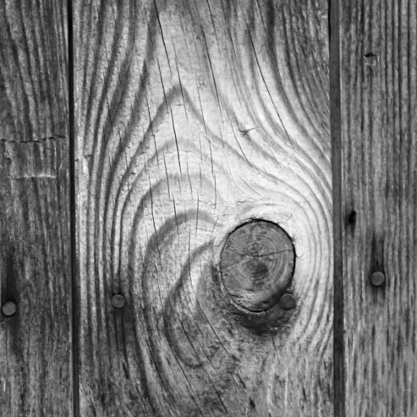
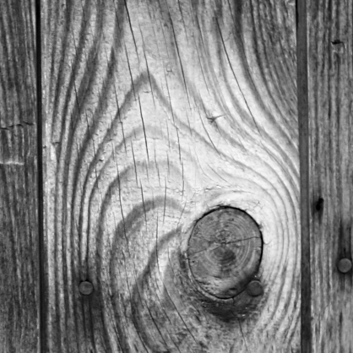
brightness constant
Notes:
and under arbitrary scene velocity, images show a combination of scaling and shifting over time.
Each image point corresponds to a fixed world point, so that the brightness at matching image points remains constant.

Slide 7
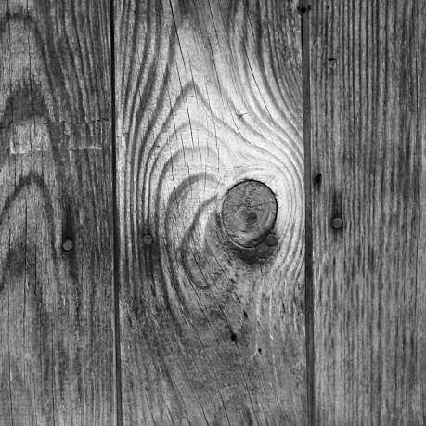



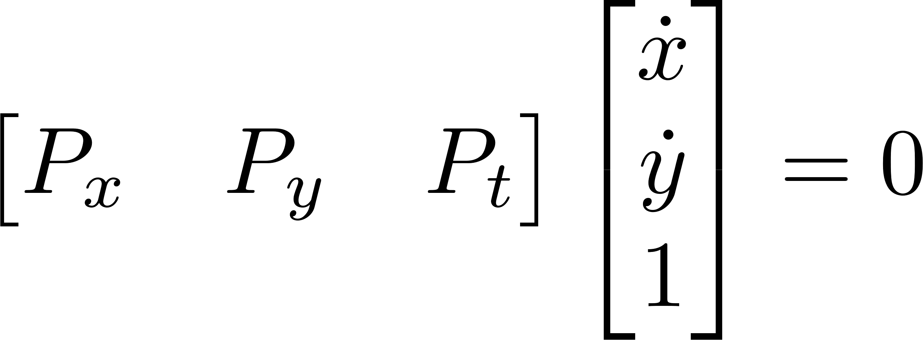
brightness constant
Notes:
When the frame rate of the camera is high enough that scene motion is subpixel, this observation gives a familiar constraint.
It says that the change in pixel brightness over time, P_t, can be expressed as a weighted sum
of the first derivatives in image coordinates x and y.

Slide 8
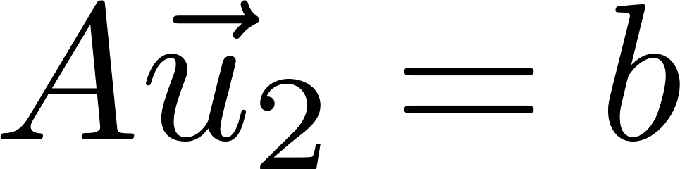
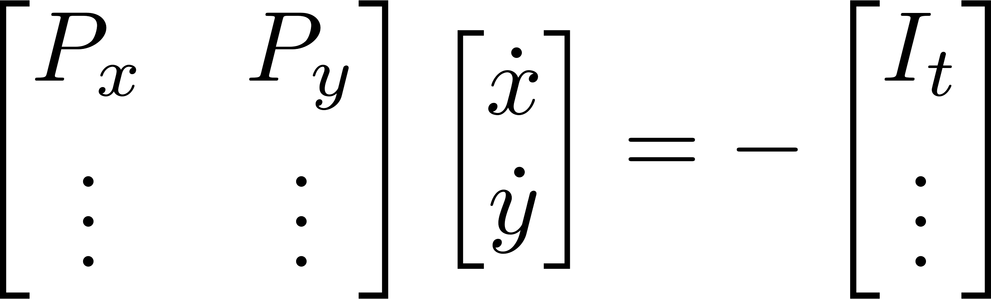
brightness constant
optical flow
Notes:
If we consider this to hold at every pixel in a patch, we can create a matrix of the derivative values at each of these pixels,
And solve a 2x2 linear system for a least squares estimate of the image motion vector.
Considering such patches across the image, we build up the optical flow field.

Slide 9

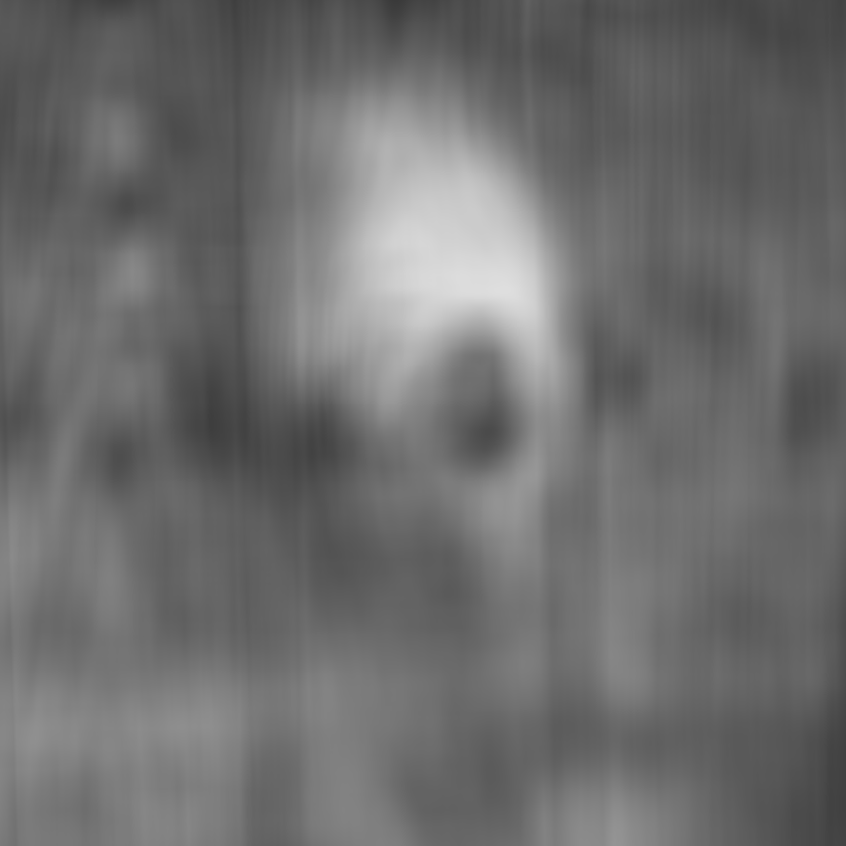
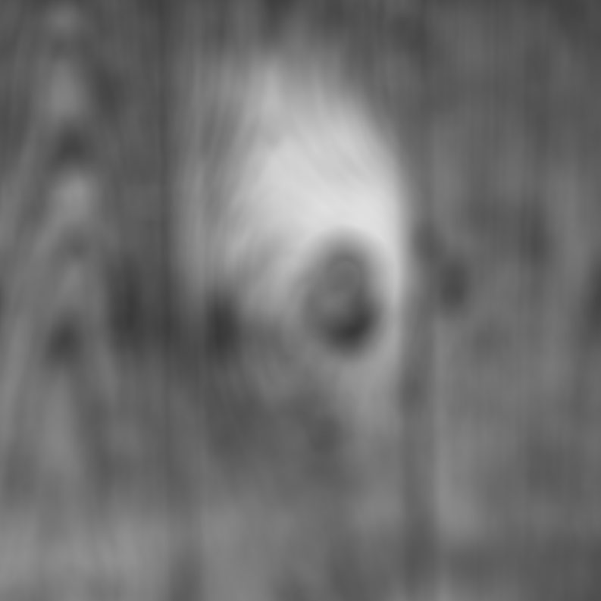


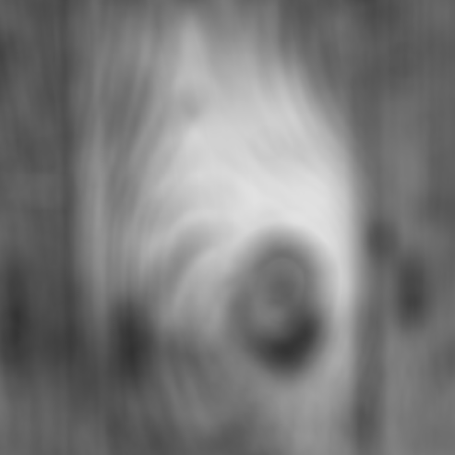

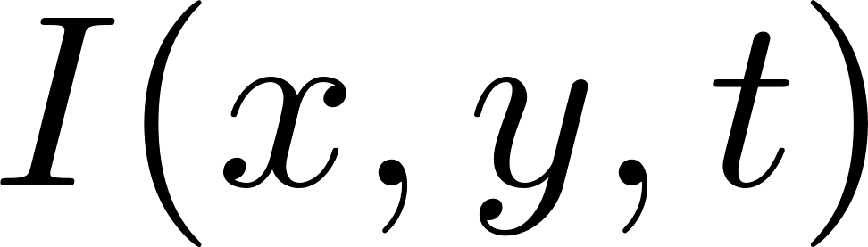
radially symmetric
aperture filter
in-focus depth
brightness not constant
Notes:
Now, we consider what happens when we open up the aperture, and place a thin lens and an attenuating filter in place of the pinhole.
This filter could be a pillbox, a binary code, or a continuous function – for our analysis, we consider the radially symmetric case, but aside from that, it can be just about anything.
Now consider the same scene we saw before, observed through a thin lens with a pillbox aperture.
Unlike the pinhole case, the object comes into and out of focus, so that in addition to image scaling and shifting, we observe changes in contrast as well. **This turns out to be a very valuable additional source of information, but it takes a specific combination of optical and computational manipulation to access it directly.
We begin with the simple observation that the brightness of a fixed point on the object is no longer constant across our images.

Slide 10
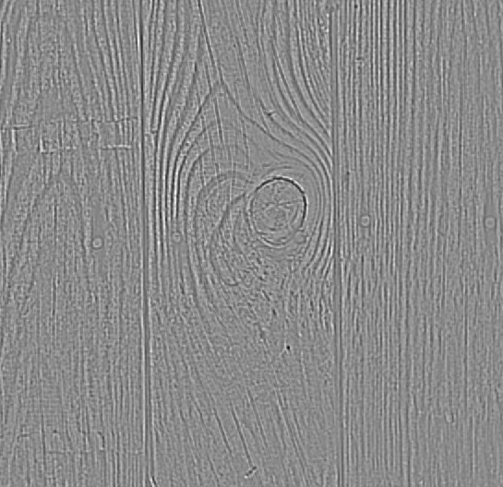
brightness not constant
!
Notes:
This is true even under differential motion,
[slow down] which means that if we compute the same derivatives as before, derivatives in pixel location (x, y) and time t, the familiar constraint on optical flow does not hold.
Instead, this weighted sum of image derivatives will leave some residual brightness change R at every pixel, which is just the amount of brightness change due to defocus, after on-image motion has been accounted for.

Slide 11
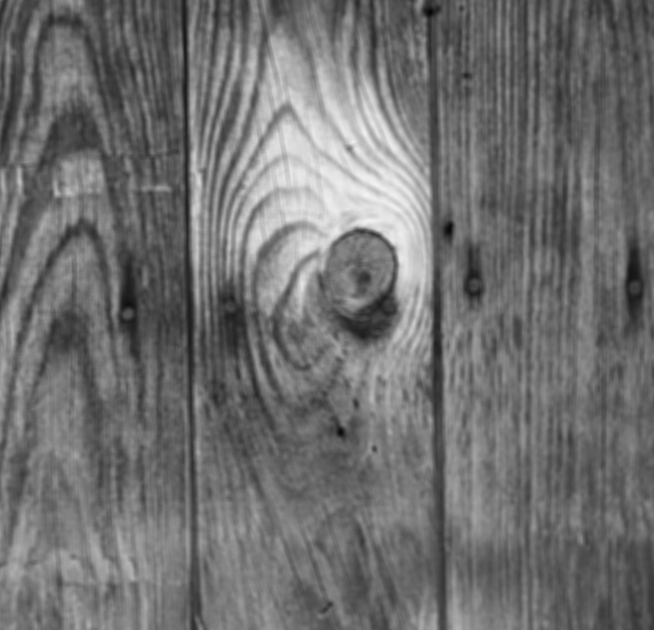
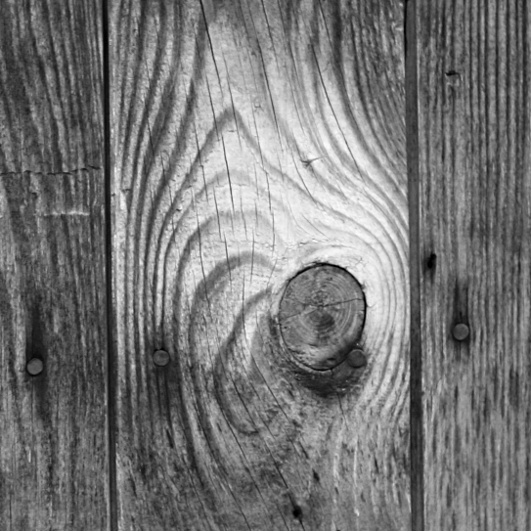


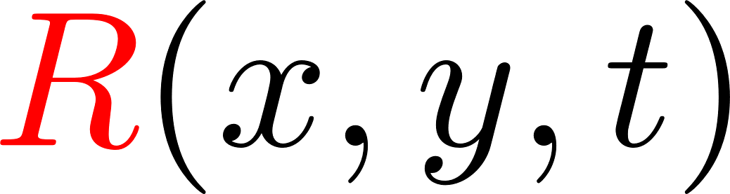
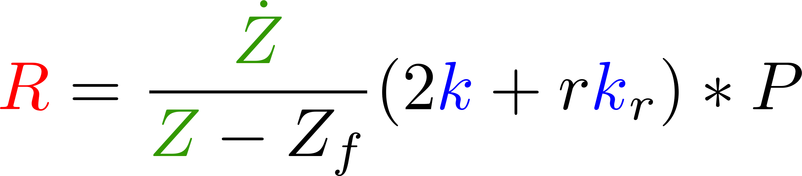
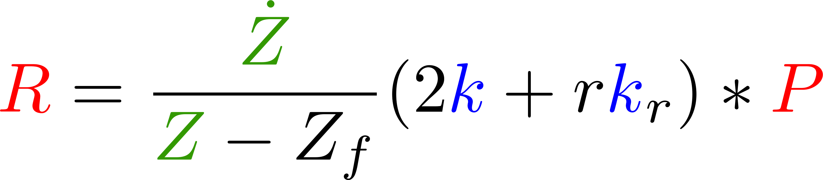
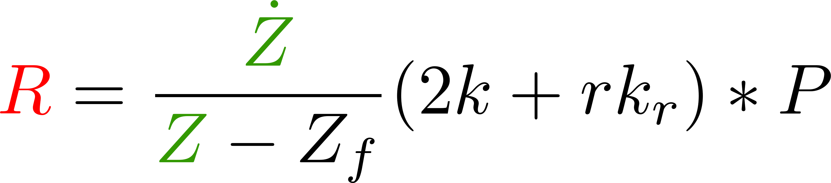
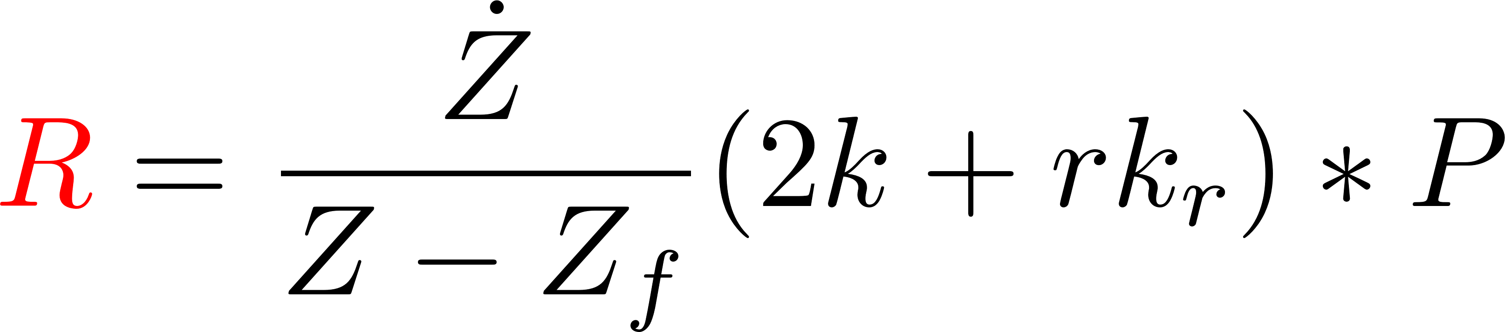

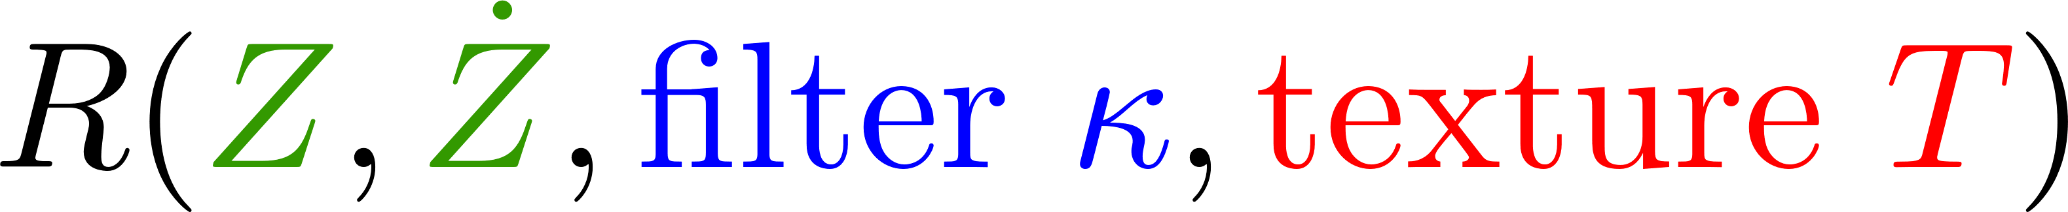

Focal Flow Residual
Notes:
With our simple thin-lens model, we can write the exact form of this residual brightness change, and render it as another image shown here.
We find that it is scaled overall by the approach velocity and the object’s depth, both of which we would like to measure.
It also depends on an expression involving the blur kernel k, which is a depth-scaled version of the filter kappa at the aperture, which we get to choose.
Unfortunately, this expression is convolved with the pinhole image P, which as we saw, is a scaled and translated version of the scene texture.
Now this really the heart of the problem. We only collect a blurred image, which means that this residual depends on information about scene geometry and texture that we do not access to. The only way to turn this term from a source of error into a useful signal, is to perform some kind of expensive inference on the underlying scene, which is likely impossible for a power-constrained microsensor,
or to find a way to measure it directly from the image.

Slide 12
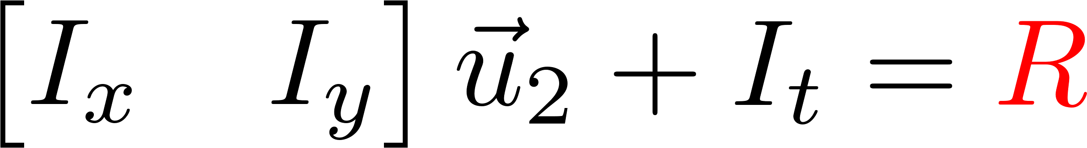
Goal: Express residual without knowing texture.
Theorem:
Aperture filter must be Gaussian.
Image operator must be Laplacian.
distributional derivative
Fourier transform,
differential equation,
require ≥ 0 and compact
Constraint:
Notes:
So this becomes our goal. We seek an image operator m, and an aperture filter kappa, so that the residual R, that is the brightness change due to defocus after on-image motion has been accounted for, is proportional to the convolution of our operator m with the blurry image I, for any texture.
We prove that this is possible, when and only when, the aperture filter is Gaussian and the image operator is the Laplacian.
I’ll skip the details of our derivation for now, and just point out that it relies on the theory of distributions, which are mathematical objects including both functions and more exotic things like the Dirac delta, rather than using the theory of differentiable functions alone. This is what allows us to simultaneously consider filters including pinholes, pillboxes, binary codes, and continuous functions.
We prove this by specifying the form of each expression, and texture independence comes from dropping the pinhole image from either side. We see that the operator applied to the blur kernel must double the original kernel and add to it its directional derivative in the radial direction. The important thing about this derivative is that we handle it using the theory of distributions, which are mathematical objects including both functions and more exotic things like the Dirac delta, rather than using function derivatives alone. This is what allows us to simultaneously consider filters including pinholes, pillboxes, binary codes, and continuous functions.
We find that this condition leads to a differential equation in the frequency domain, which we solve for a large family of solutions. We restrict this family by requiring that the aperture filter have nonnegative transmittance, through a combination of Bochner’s theorem and the Fourier Slice Theorem, and we require that the image operator draw on a sub-infinite number of pixels. Under these requirements, a unique and familiar possibility remains.
From here, the focal flow constraint is all but derived. We assume Gaussian blur,
and we note that after accounting for on-image motion, a quantity remains
Which is proportional to the image Laplacian.
We then split the spatial derivative terms Ix and Iy into translation and expansion components, by including their spatially-weighted sum.
Moving the Laplacian to the other side of the equation produces our constraint in its final form.

Slide 13
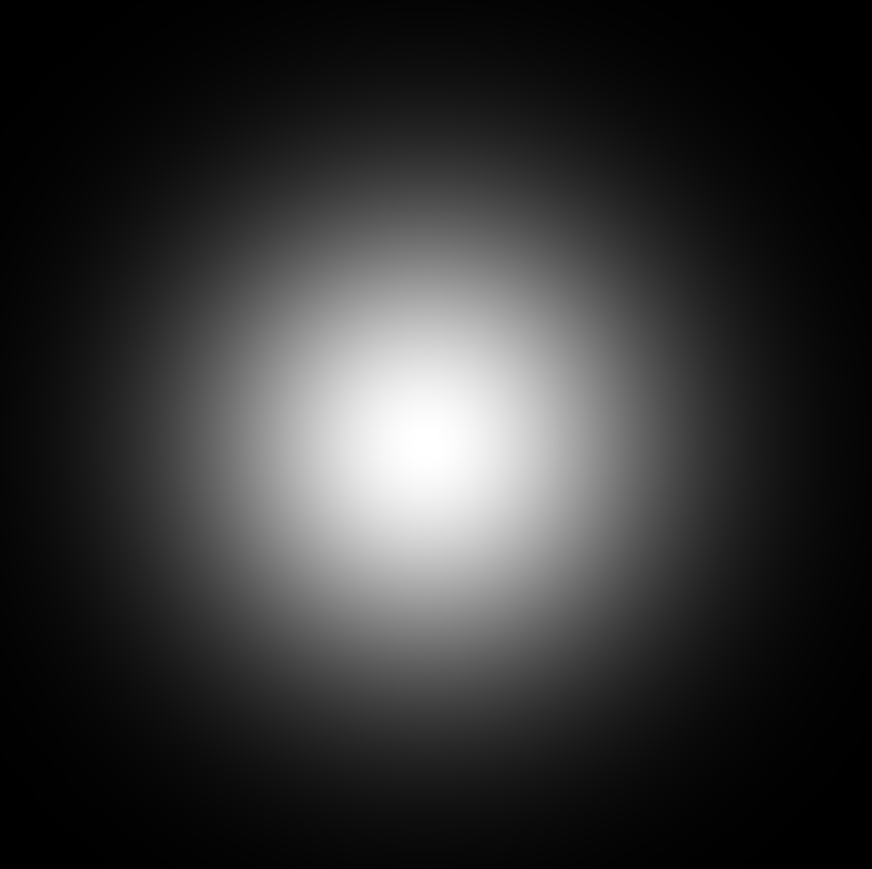

brightness not constant
Notes:
So this is what our theorem means. We can create an extremely efficient patch-wise measurement algorithm, by simply computing image derivatives as before,
now augmented with the second spatial derivatives.

Slide 14
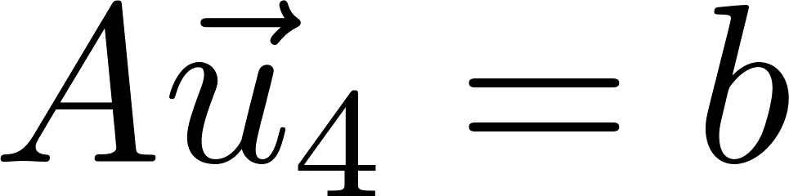
Notes:
Within each patch, we accumulate the derivatives into a matrix equation.
The least-squares solution to this equation gives a four-vector
and this is equivalent to knowing the depth and velocity at the back-projection of the patch.
..And that’s it. We’re done. There’s no iteration, there’s no intermediate inference about displacements or blur kernels or texture features, there’s no netwok, there’s no data --- it’s a simple, feed-forward computation, derived from first principles and requiring very few multiplies and adds. We were looking for a very cheap way to measure depth and velocity from images, and that’s exactly what this is.

Slide 15
Outline
1. focal flow equation
        independent of texture
        unique constraint: Gaussian blur
2. experiments
Notes:
So now I’ve shown you our per-pixel constraint on image derivatives and scene quantities. I’ve told you that it’s valid for any scene texture, that it is the only linear constraint with this invariance, and that it requires the blur kernels of the camera to be Gaussian.
Now we turn to experimental results, to answer the question,

Slide 16

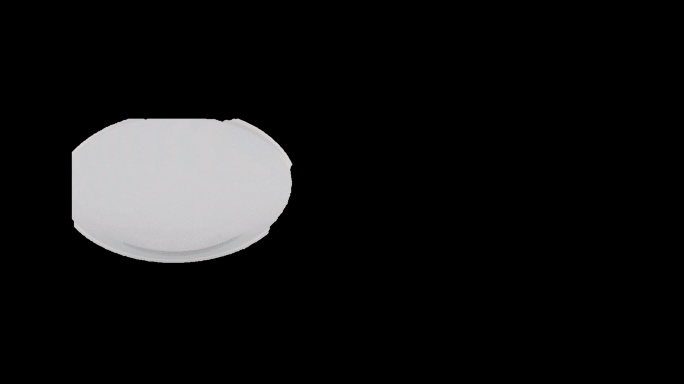
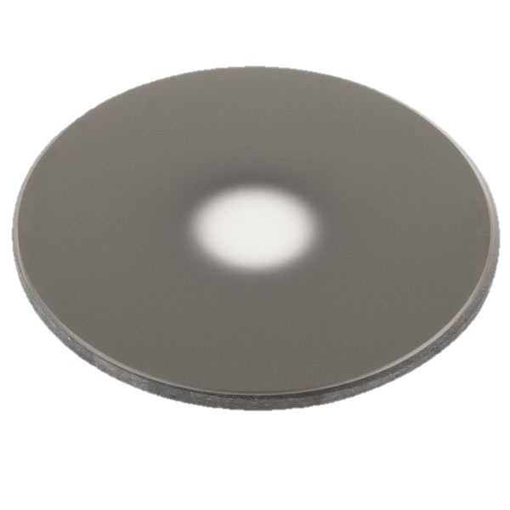
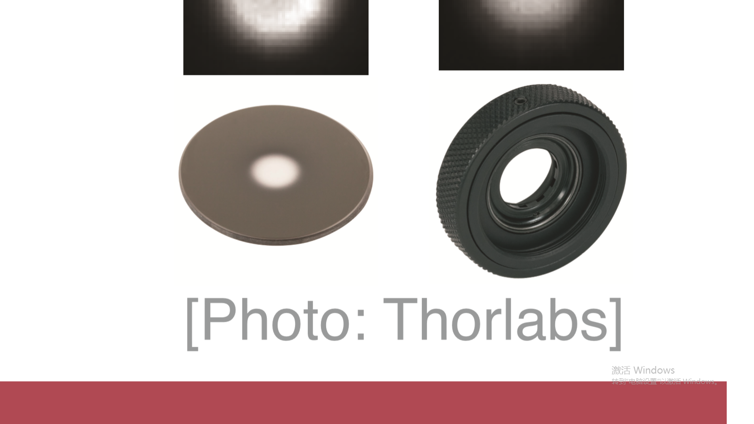
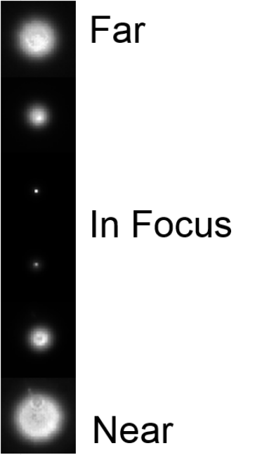
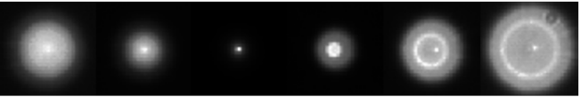



Does it work in practice?
ideal lens + ideal Gaussian filter
In practice: thick lens
real lens + real Gaussian filter
real lens + real pillbox aperture
photos: Thorlabs
Notes:
Does this algorithm work in practice?
Our constraint holds exactly, only when a perfect Gaussian filter, on a perfect thin lens, creates perfect Gaussian blur kernels.
Real cameras rely on thick lenses, and the resulting blur kernels look more like this,
through a Gaussian filter,
or like this through a pillbox aperture. In both cases, there are obvious deviations from the ideal Gaussian blur.
Now, we can still apply our algorithm, by computing the same derivatives and solving the same linear system in the least-squares sense. But our constraint is only approximately true. Instead of refining our optics we ask, will it work anyway?

Slide 17
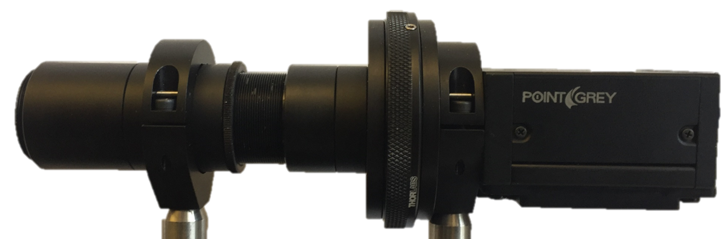

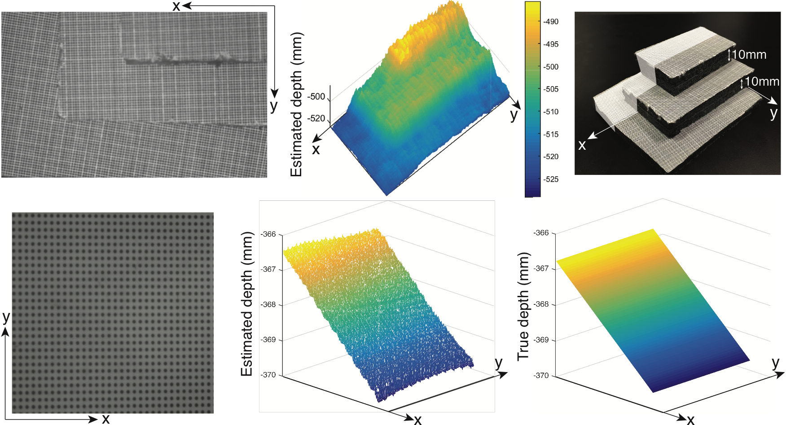
Results
Captured Images
Notes:
Happily, we find that a prototype camera,
equipped with a single thick lens and an imperfect Gaussian filter---or in fact a plain pillbox aperture---is able to perform the measurements we described.
We created a small multi-plane scene, which was imaged at precise depth intervals as it came into and went out of focus.
Shown here is a triplet of images,
over which we collected derivatives into per-patch matrices centered at each pixel,
and solved for the depth and 3D velocity of the backprojection of each of these pixels.
And from this simple measurement algorithm, we recover the shape, location, and speed of the object accurately.

Slide 18
Results
Captured Images (Partial)
Notes:
We also show a simple slanted plane,
From which we collected these images
And considered these larger patches,
Again collecting depth estimates
Consistent with ground truth.

Slide 19
Working Range
Notes:
I’d like to speak briefly on the working range of this sensor. Fundamentally, the focal flow cue relies on small changes in brightness, both between adjacent pixels and within a single pixel over time. When an object is very out-of-focus, its images will be blurred out, and these changes become quite small.
So this is the kind of behavior you can expect. Near the camera’s in-focus depth, shown by the dotted line, we recover high-accuracy depth measurements, shown by their proximity to ground truth on the slanted black line. But beyond a certain distance in either direction, the accuracy of our measurements rapidly declines.
As the camera is focused farther away, it has a larger depth of field, and correspondingly, a larger range for useful depth estimates.
This trend continues as we focus farther out,
with an increase in measurement variance as the working range grows – so we trade off precision for range when designing the optics of the system.
This also holds for the accompanying speed measurements, shown here with ground truth on the horizontal black line.
We provide a theoretical analysis of the cue's sensitivity in our paper and several systematic experiments in the associated technical report.

Slide 20
Trade-offs
Limitations
depth of field
  aperture size
  in-focus depth
  focal length
sensor resolution
pixel size
frame rate
bit depth
sensor noise
low-contrast texture
scene deviations from rigid, front-
-parallel planes
Future Work
regularization, robust algorithms, multiscale methods, etc.
Power and size
Performance?
Notes:
In addition to this trade-off in the optics,
we identify another in sensor resolution over space, time, and brightness. Strength in one of these areas can theoretically mitigate weakness in another. However, we have not yet developed multiscale methods for this cue, so these resolutions will affect the textures and velocities that are well-measured.
As it stands, our measurement’s performance suffers under sensor noise, and just like stereo, depth from defocus, or optical flow, the focal flow cue breaks down locally in textureless regions, in regions that have high slant or curvature, and at discontinuities in shape.
And while we focused on efficiency, there are many possible trade-offs to be made between performance and computational cost, which we have not yet begun to characterize. So there’s a lot of work to be done, and we hope that you’ll join us in exploring and experimenting with this new cue.

Slide 21
Focal Flow
code and additional results:
vision.seas.harvard.edu/focalflow
Notes:
Thank you.

